Slide 1


CM20315 - Machine Learning
Prof. Simon Prince
5. Loss functions

Slide 2
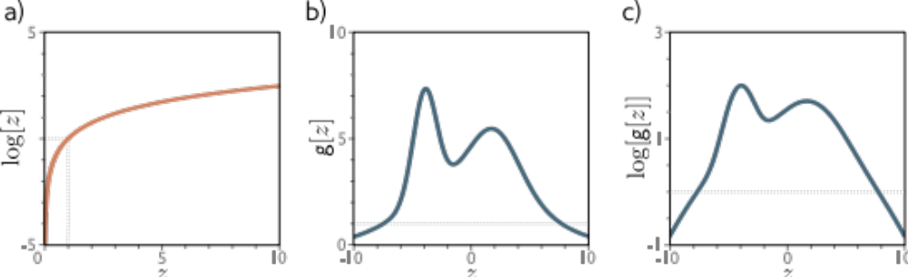

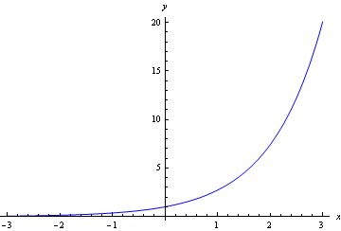


Log and exp functions
Log
Exp
Two rules:

Slide 3
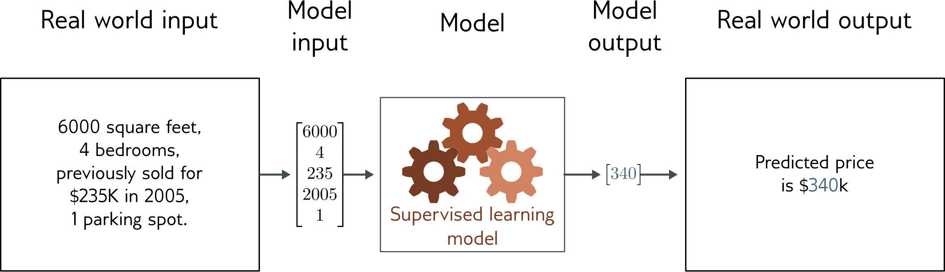
Regression
Univariate regression problem (one output, real value)
Fully connected network

Slide 4
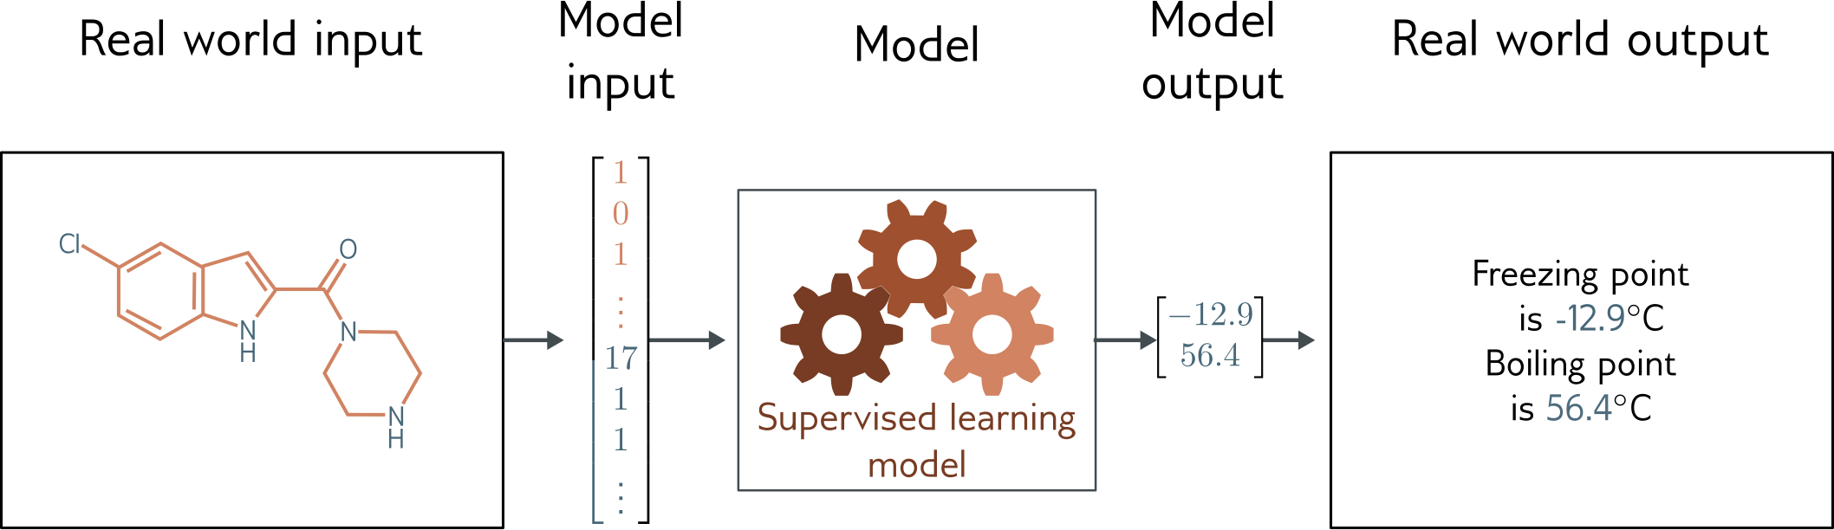
Graph regression
Multivariate regression problem (>1 output, real value)
Graph neural network

Slide 5
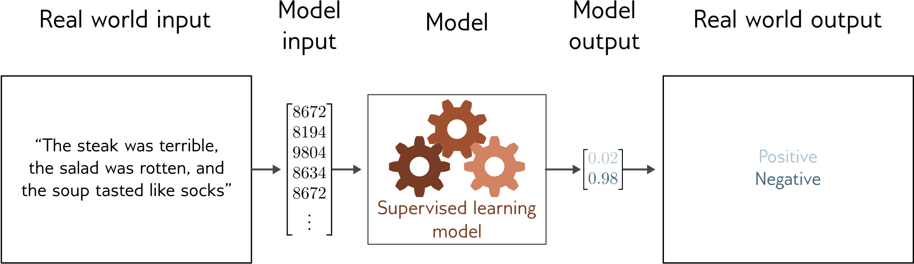
Text classification
Binary classification problem (two discrete classes)
Transformer network

Slide 6
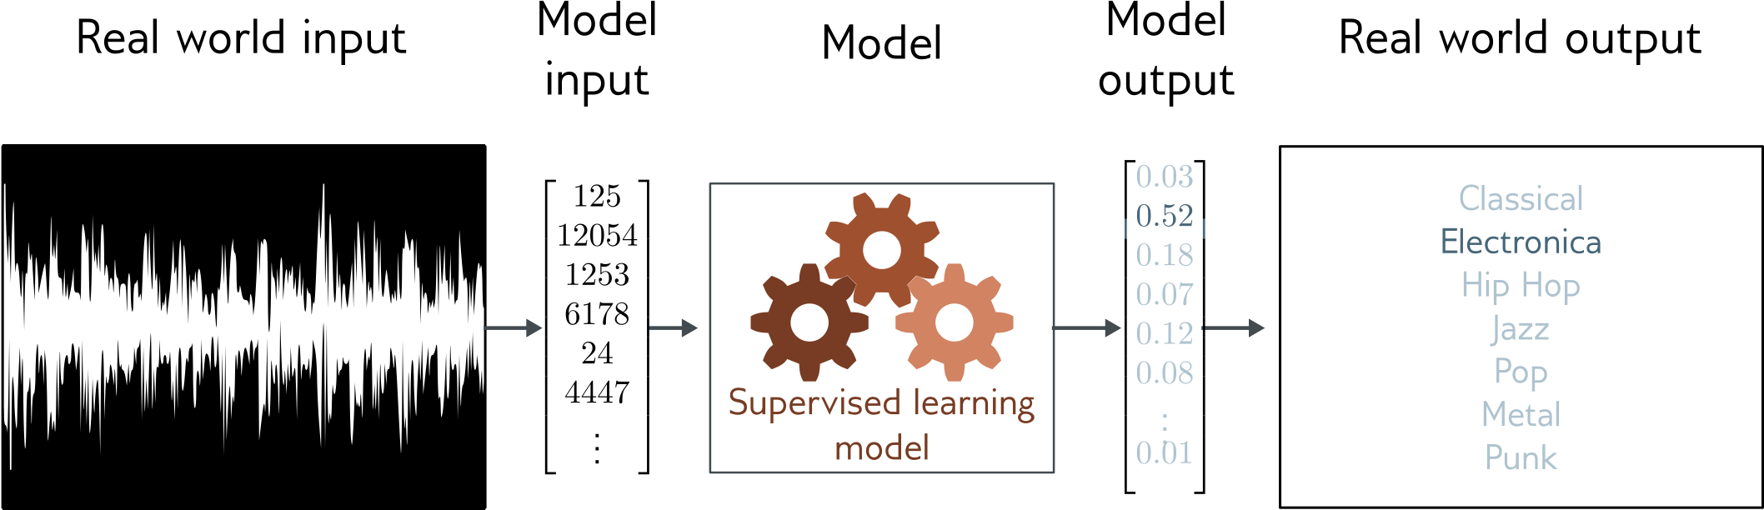
Music genre classification
Multiclass classification problem (discrete classes, >2 possible values)
Convolutional network

Slide 7
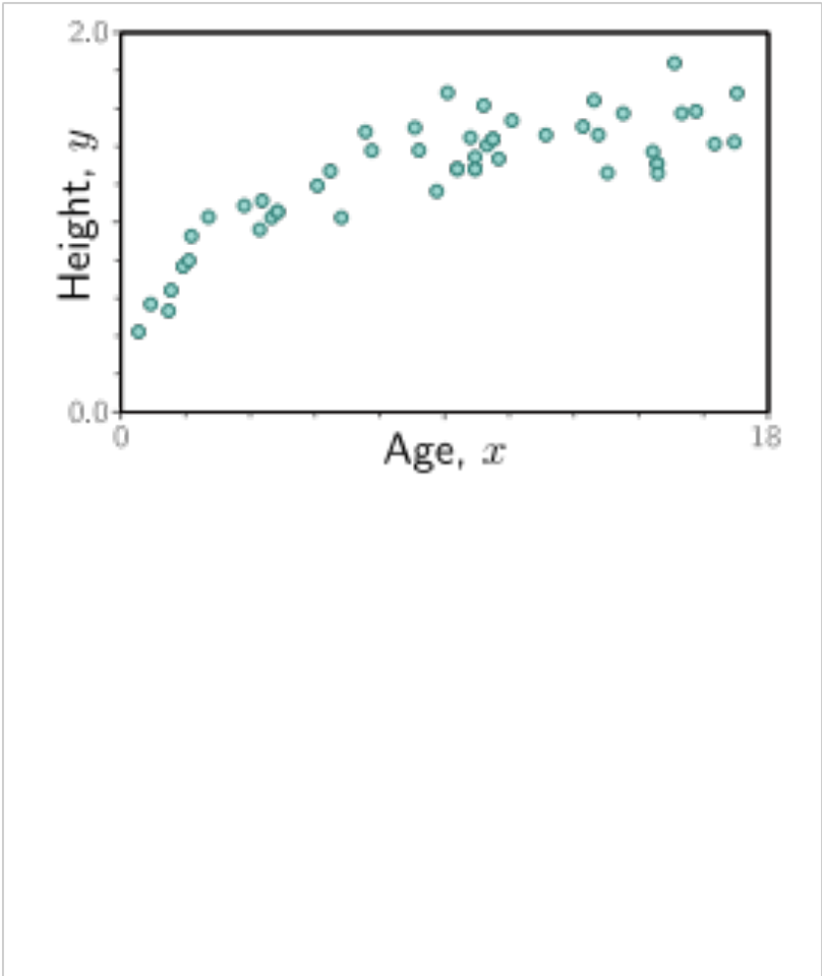

Slide 8
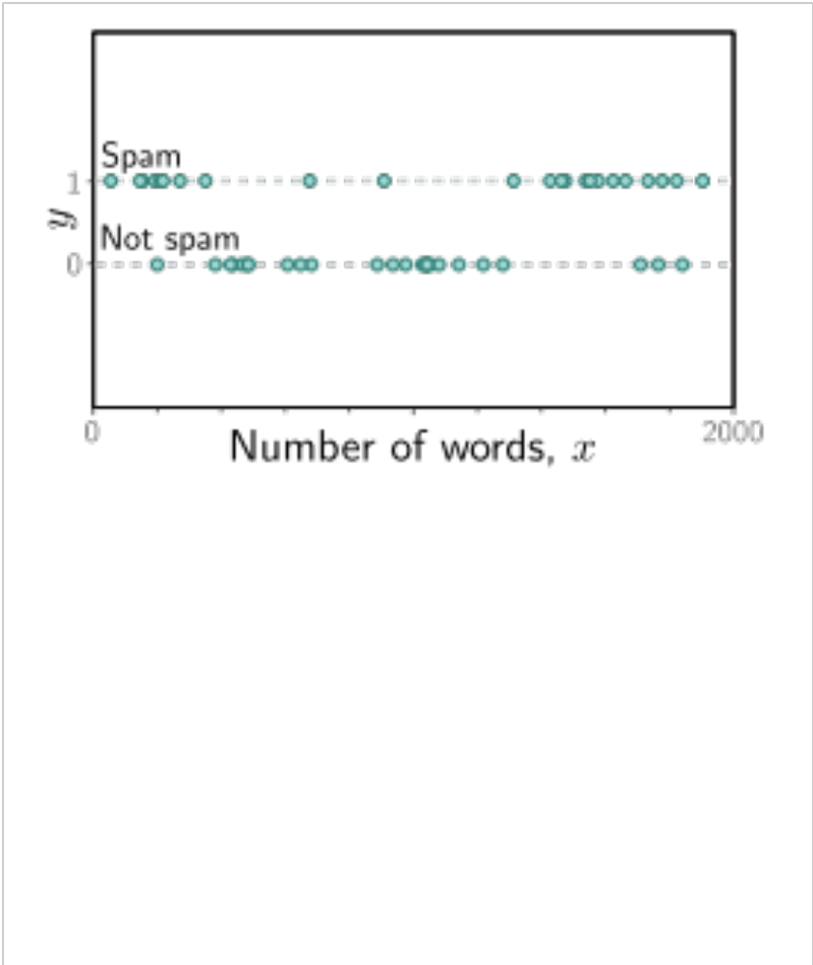

Slide 9
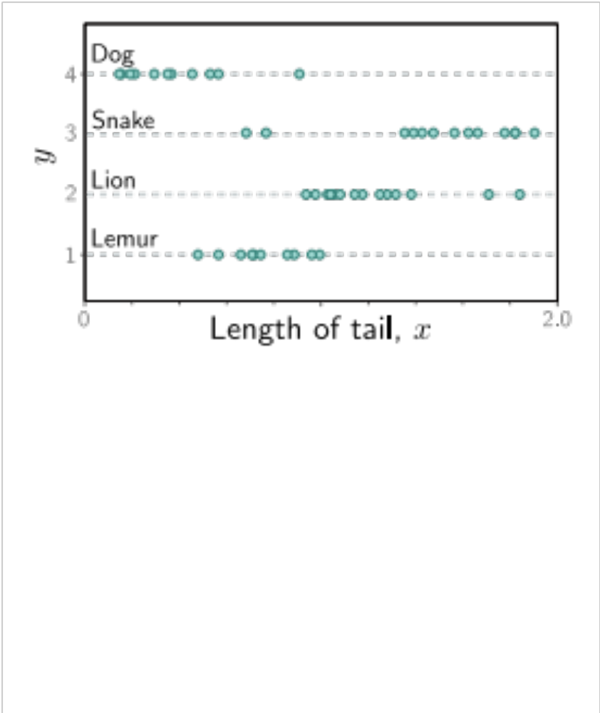

Slide 11
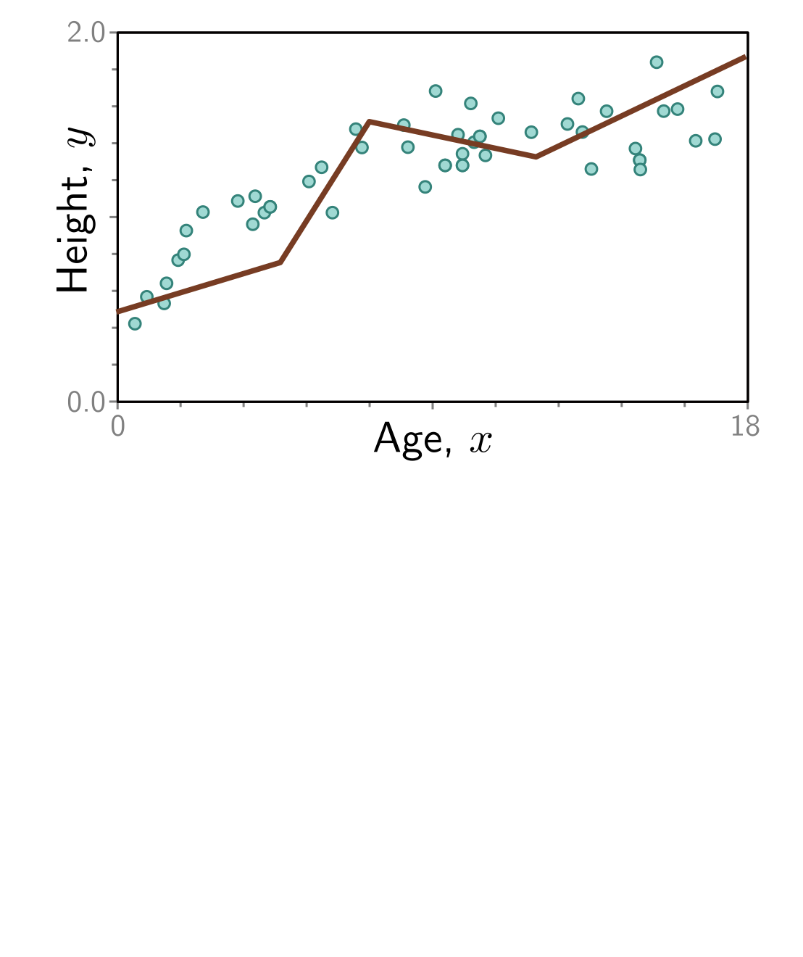

Slide 14
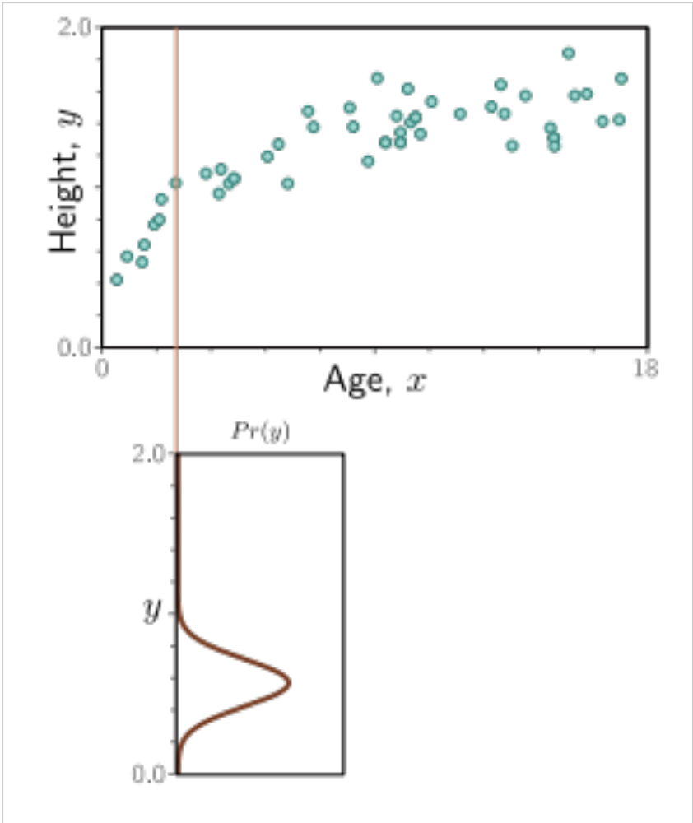

Slide 15
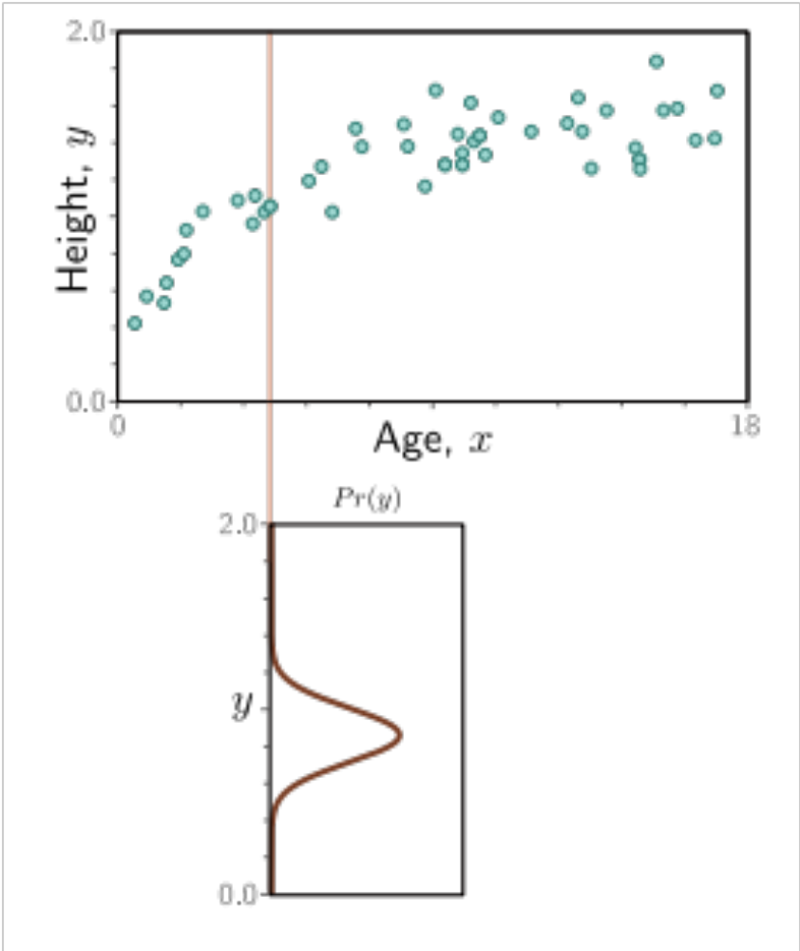

Slide 16
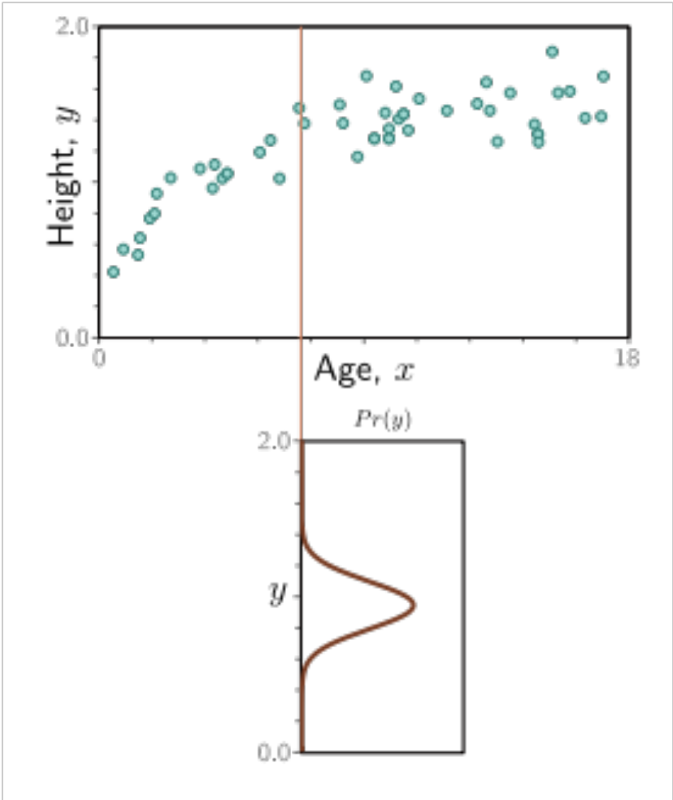

Slide 17
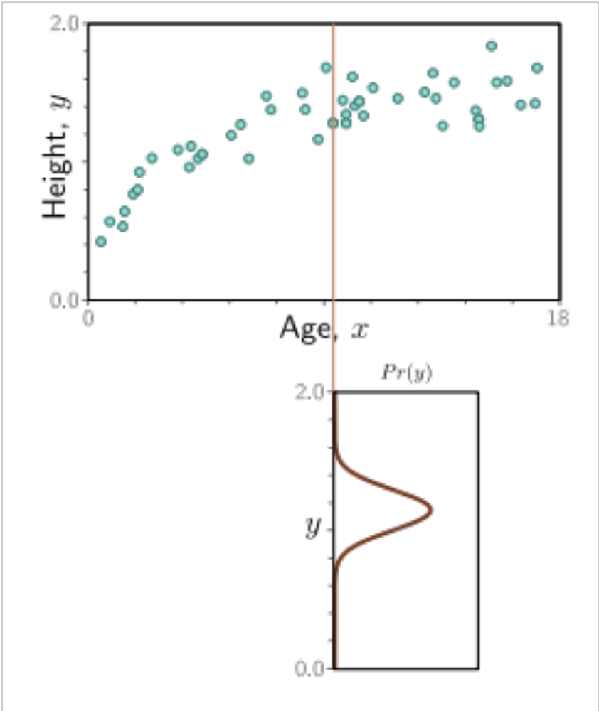

Slide 18
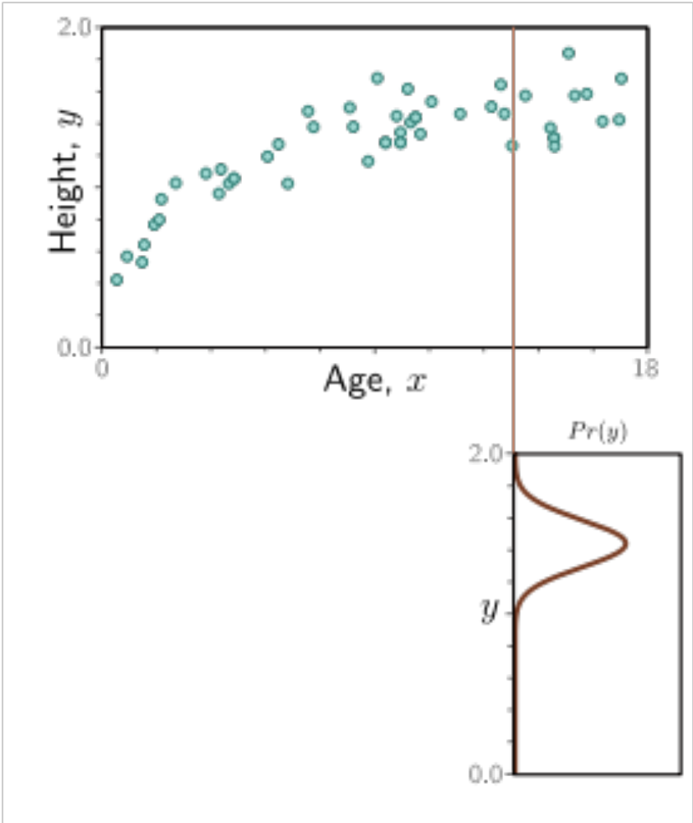

Slide 20
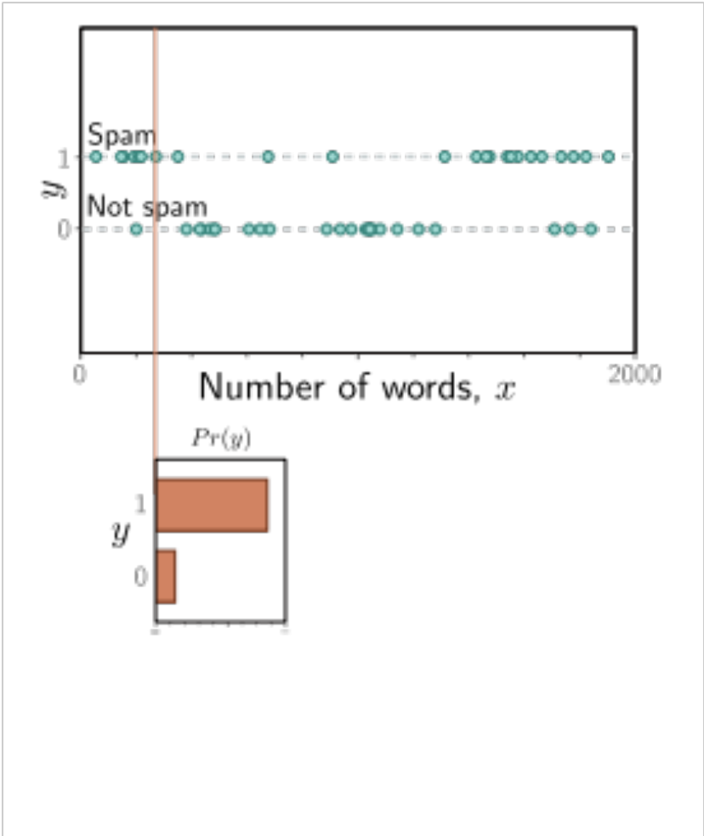

Slide 21
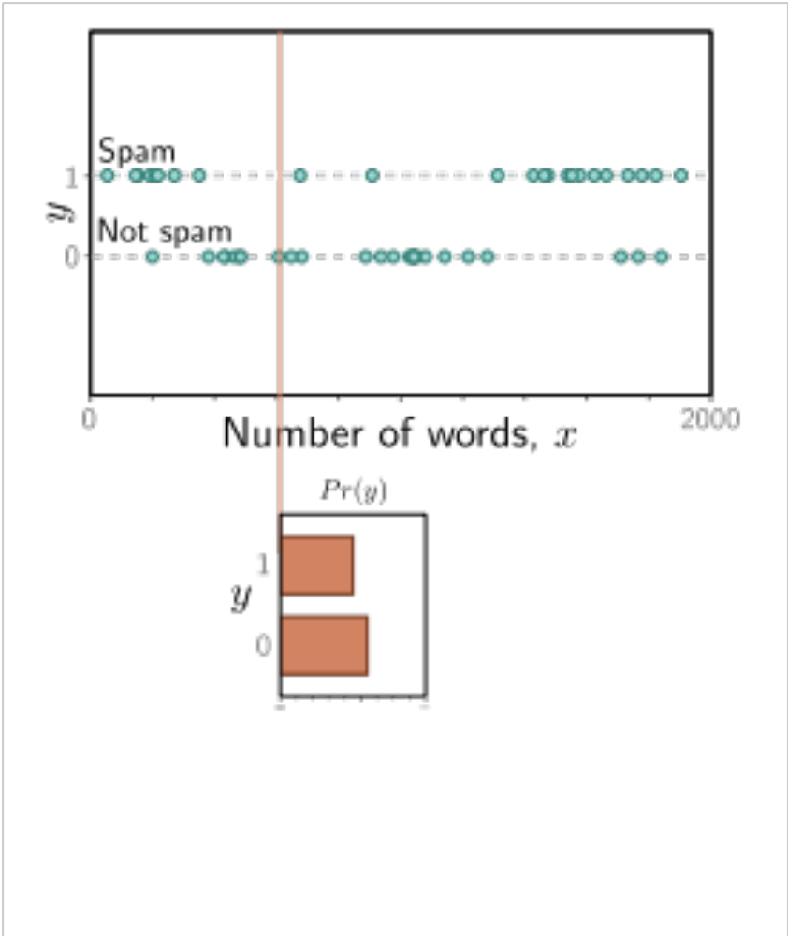

Slide 22
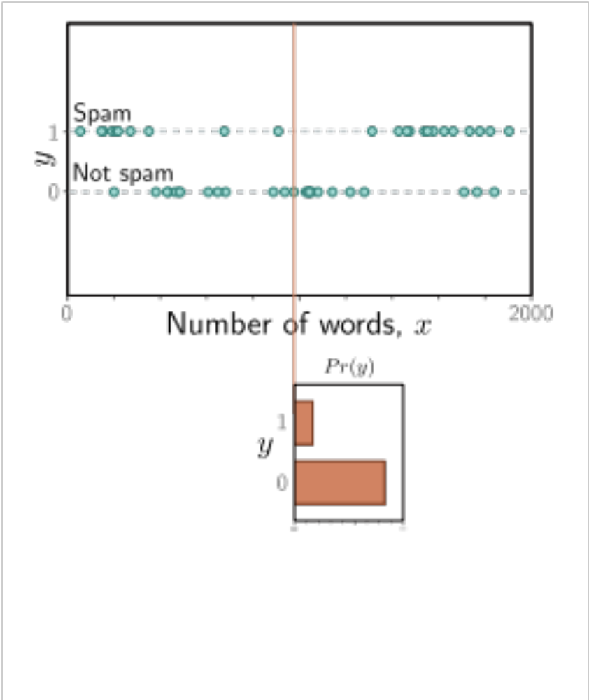

Slide 23
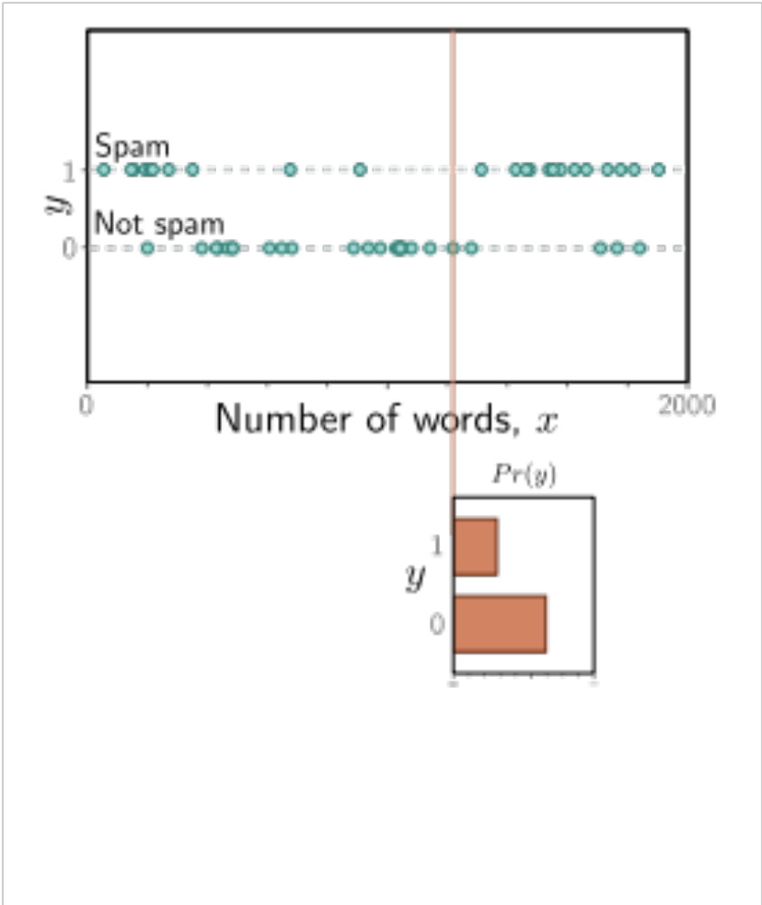

Slide 24
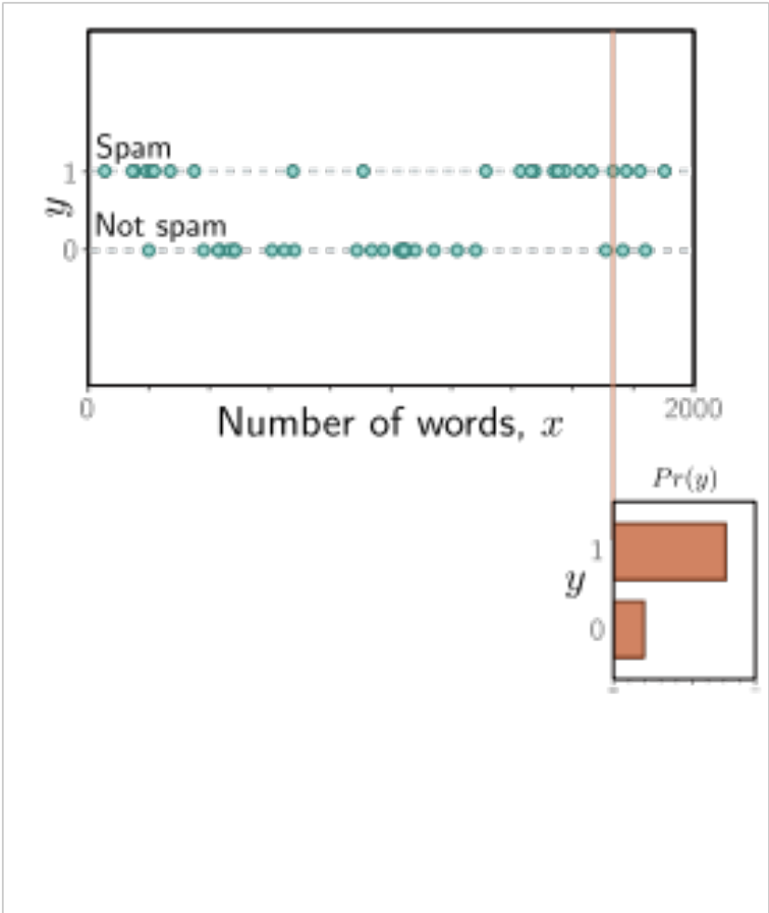

Slide 26
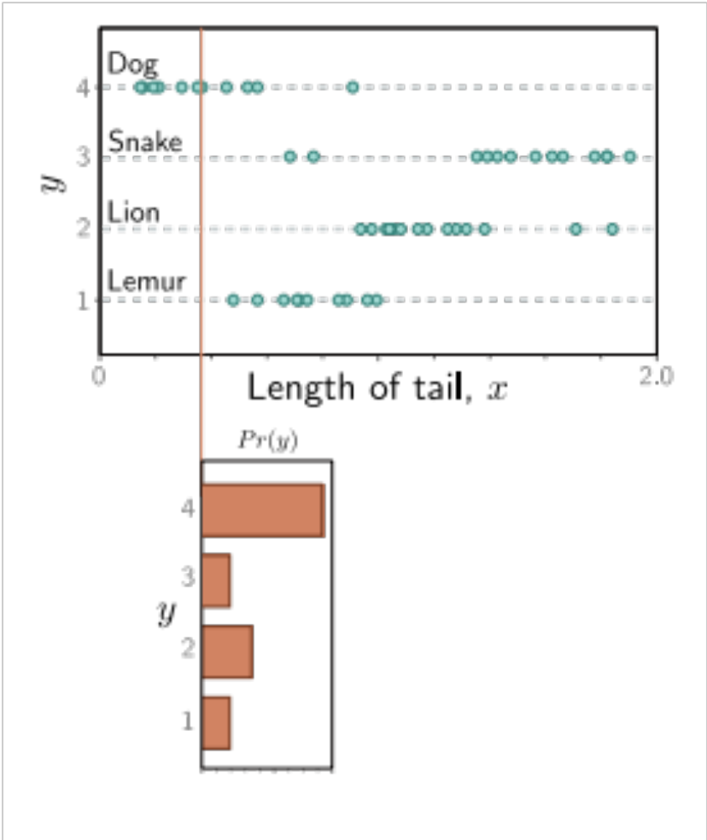

Slide 27
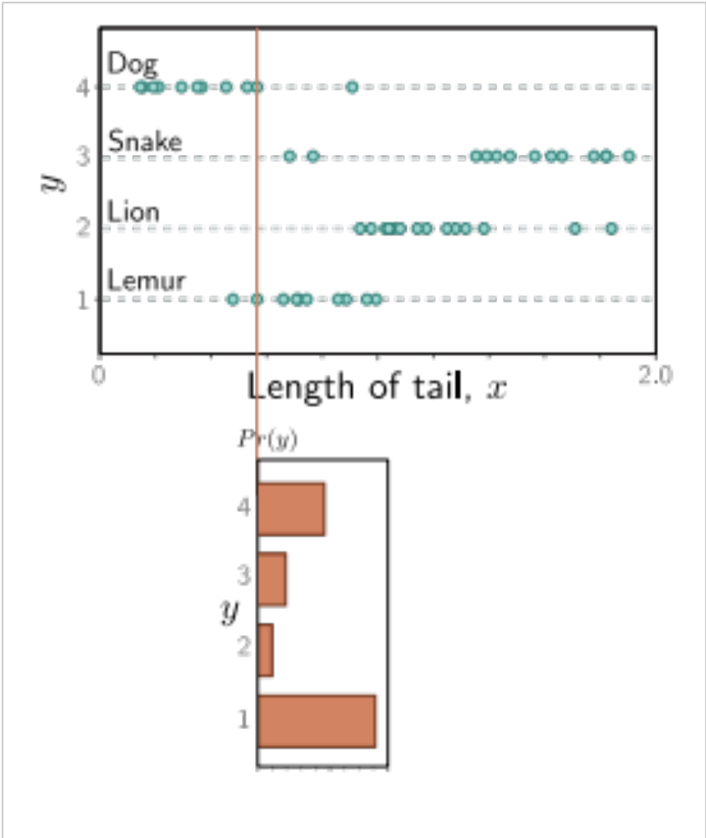

Slide 28
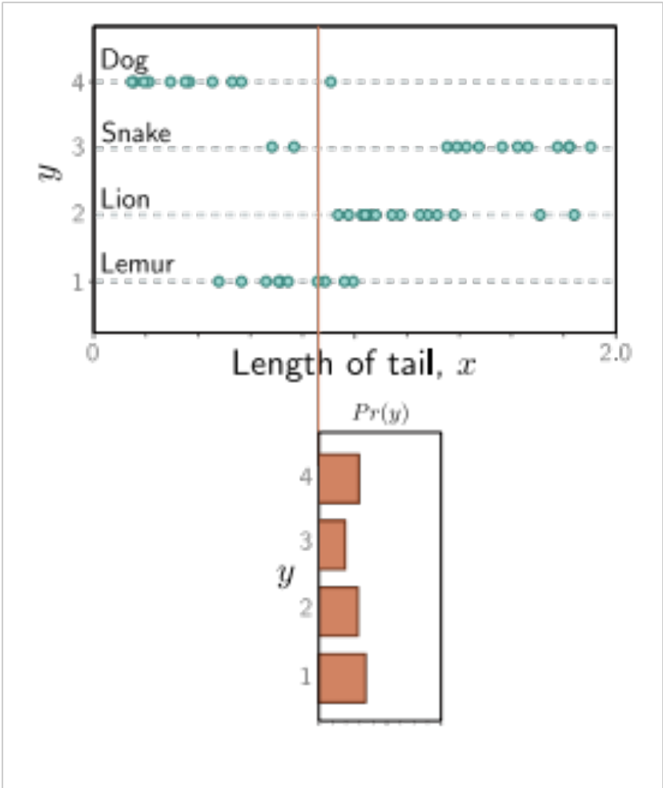

Slide 29
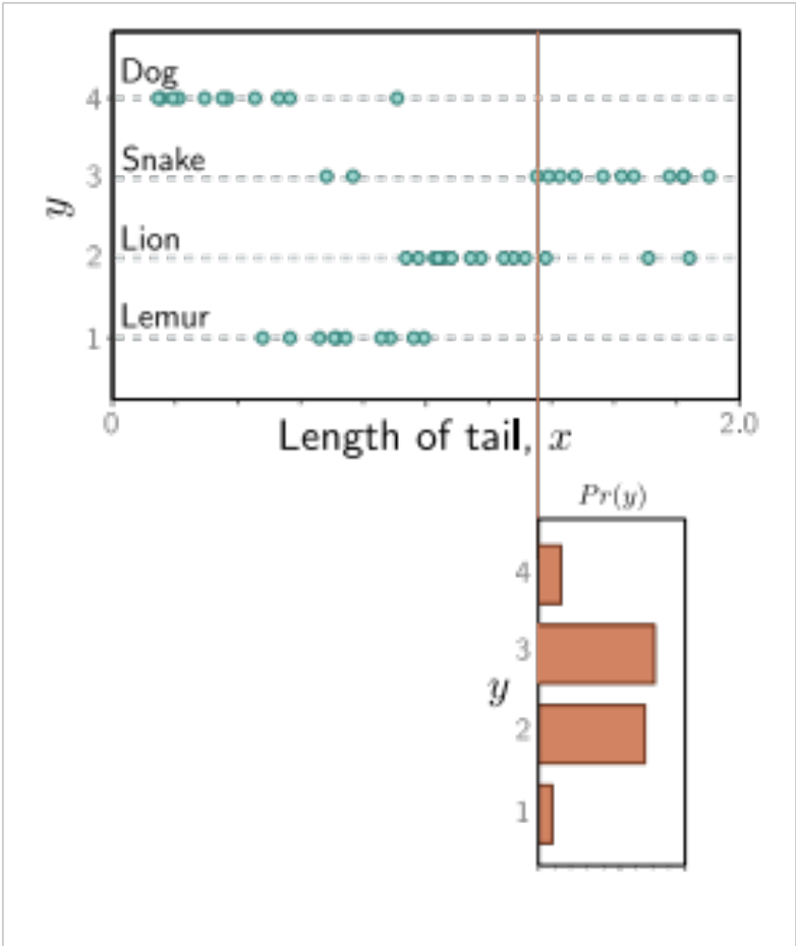

Slide 30
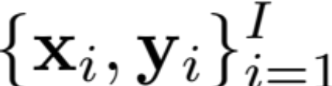
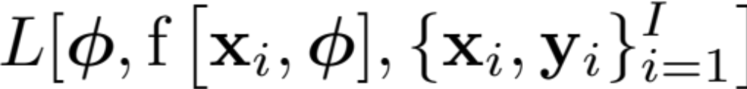

Loss function
Training dataset of I pairs of input/output examples:
Loss function or cost function measures how bad model is:
or for short:
Returns a scalar that is smaller when model maps inputs to outputs better

Slide 31
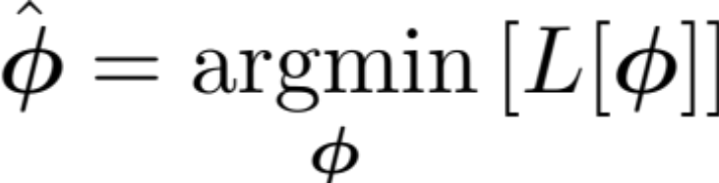
Training
Loss function:
Find the parameters that minimize the loss:
Returns a scalar that is smaller when model maps inputs to outputs better

Slide 32
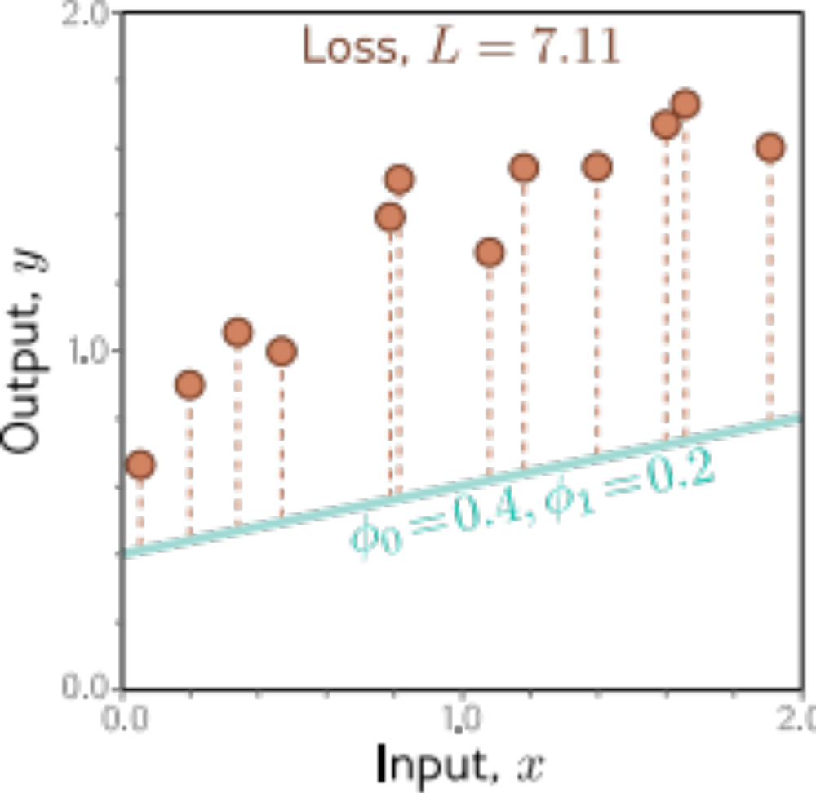
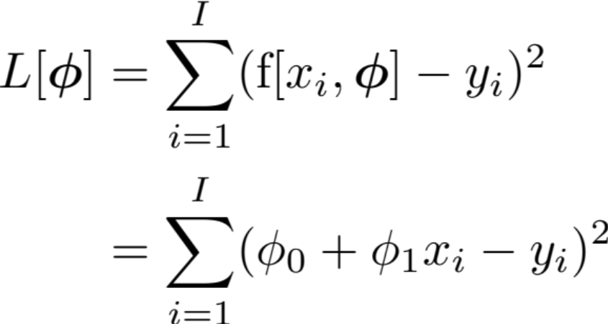
Example: 1D Linear regression loss function
Loss function:
“Least squares loss function”

Slide 33
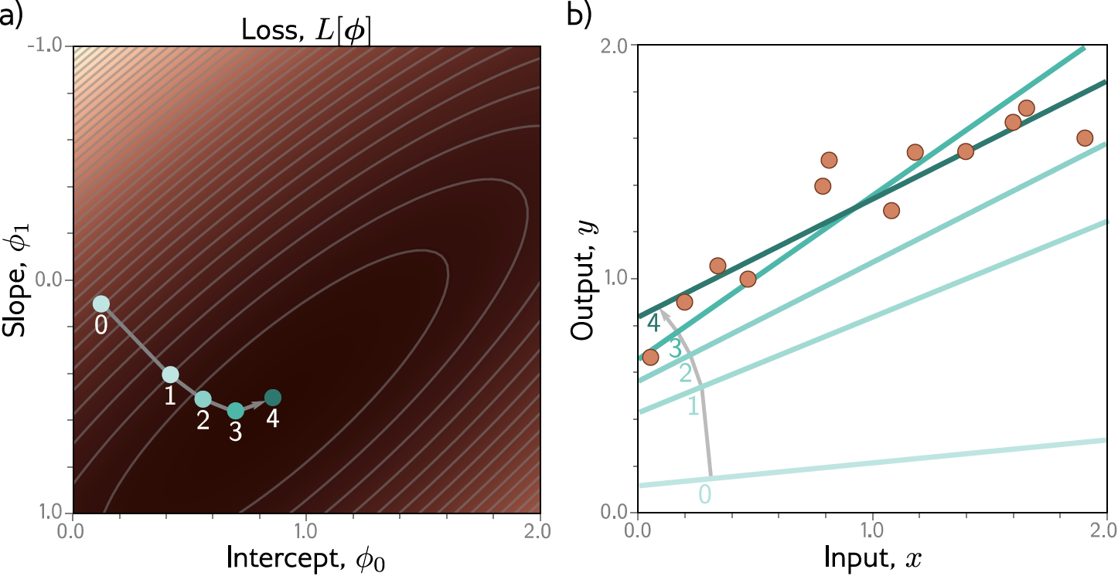
Example: 1D Linear regression training
This technique is known as gradient descent

Slide 34
Loss functions
Maximum likelihood
Recipe for loss functions
Example 1: univariate regression
Example 2: binary classification
Example 3: multiclass classification
Other types of data
Multiple outputs
Cross entropy

Slide 35
How to construct loss functions
Model predicts output y given input x

Slide 36
How to construct loss functions
Model predicts output y given input x

Slide 37

How to construct loss functions
Model predicts output y given input x
Model predicts a conditional probability distribution:
over outputs y given inputs x.
Loss function aims to make the outputs have high probability

Slide 38


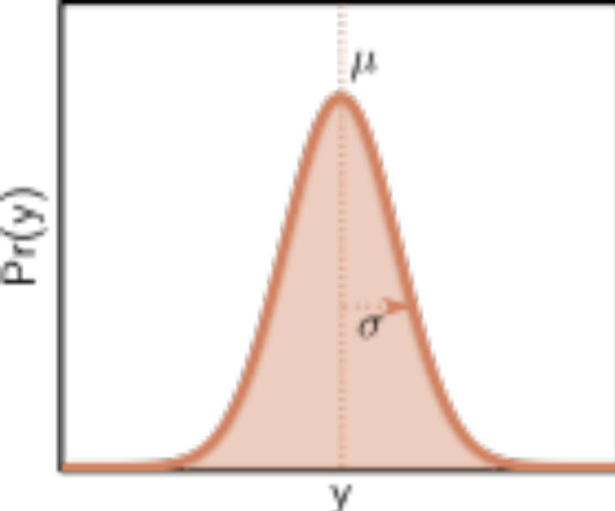
How can a model predict a probability distribution?
Pick a known distribution (e.g., normal distribution) to model output y with parameters
e.g., the normal distribution
2. Use model to predict parameters of probability distribution

Slide 39
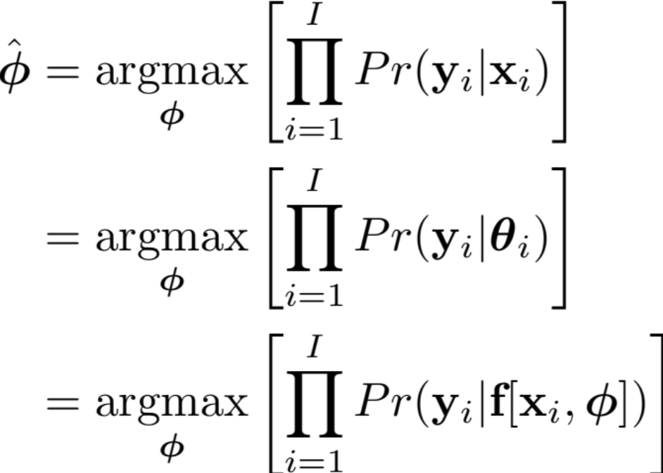

Maximum likelihood criterion
When we consider this probability as a function of the parameters , we call it a likelihood.

Slide 40
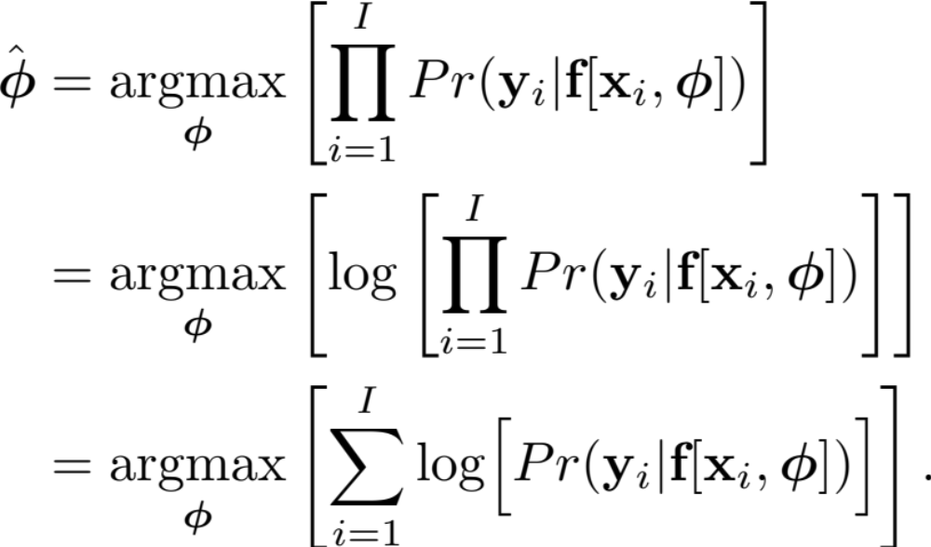
Problem:
The terms in this product might all be small
The product might get so small that we can’t easily represent it

Slide 41
The log function is monotonic
Maximum of the logarithm of a function is in the same place as maximum of function

Slide 42
Maximum log likelihood
Now it’s a sum of terms, so doesn’t matter so much if the terms are small

Slide 43
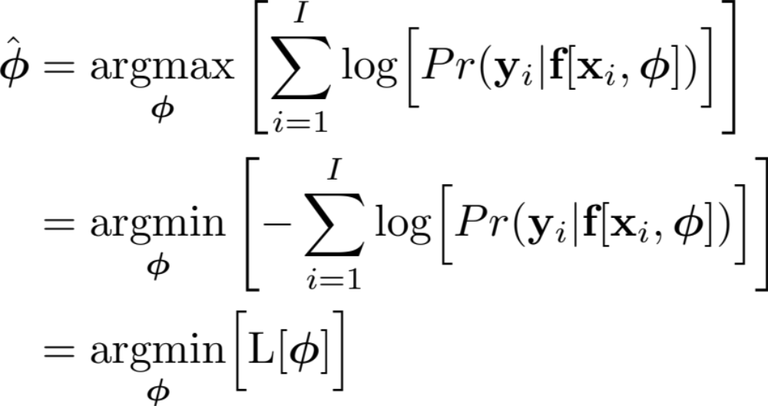
Minimizing negative log likelihood
By convention, we minimize things (i.e., a loss)

Slide 44
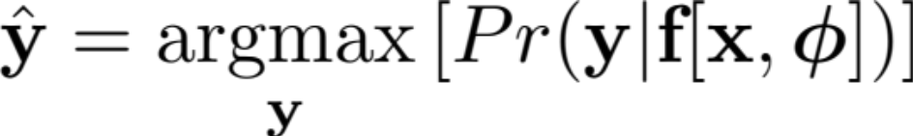
Inference
But now we predict a probability distribution
We need an actual prediction (point estimate)
Find the peak of the probability distribution (i.e., mean for normal)

Slide 45
Loss functions
Maximum likelihood
Recipe for loss functions
Example 1: univariate regression
Example 2: binary classification
Example 3: multiclass classification
Other types of data
Multiple outputs
Cross entropy

Slide 46
Recipe for loss functions

Slide 47
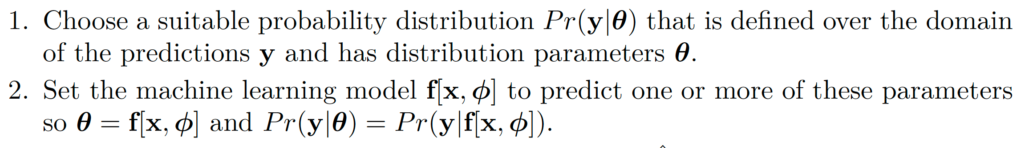
Recipe for loss functions

Slide 48
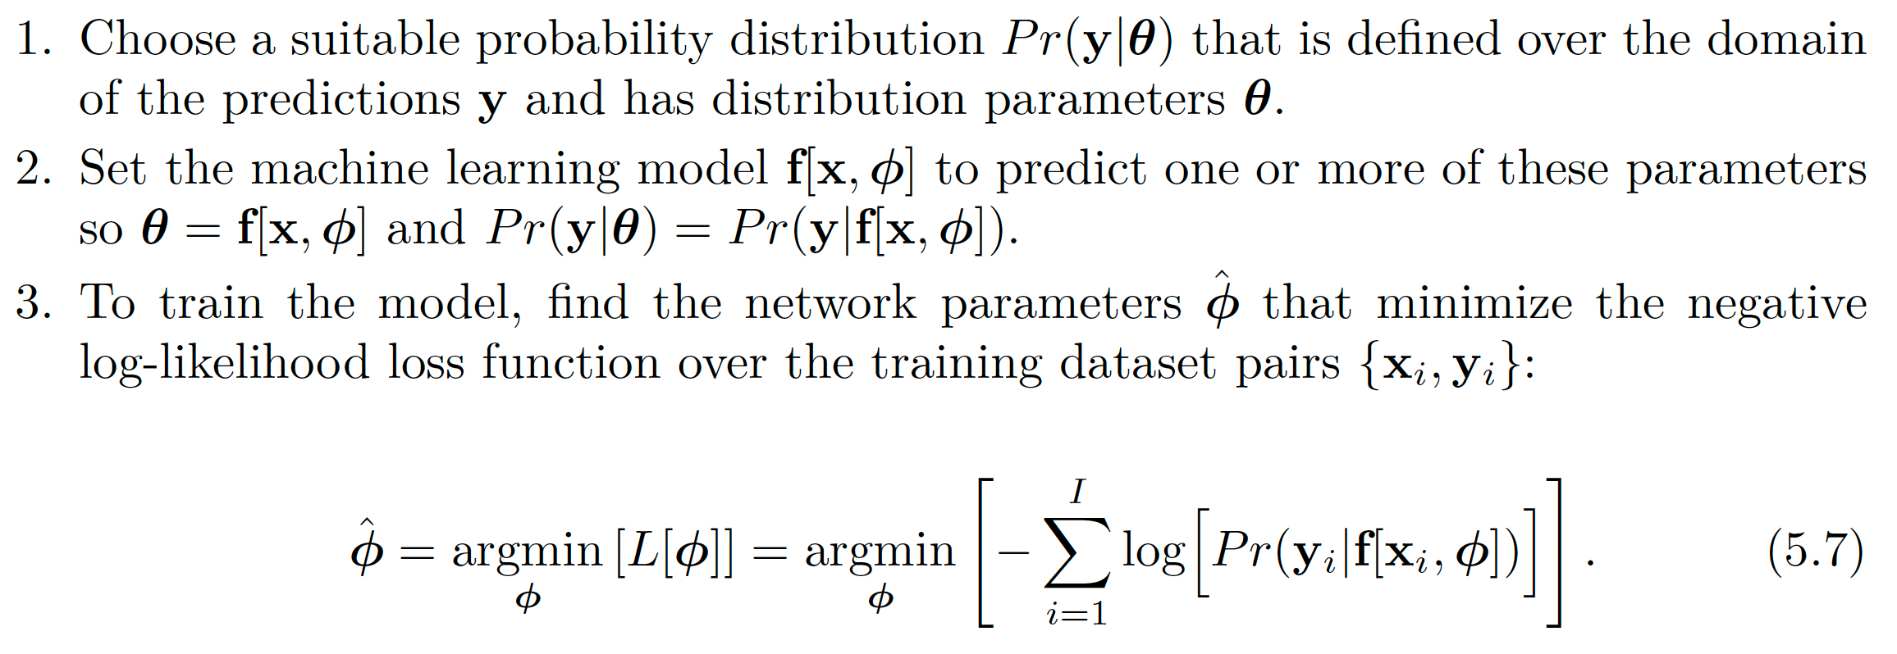
Recipe for loss functions

Slide 49
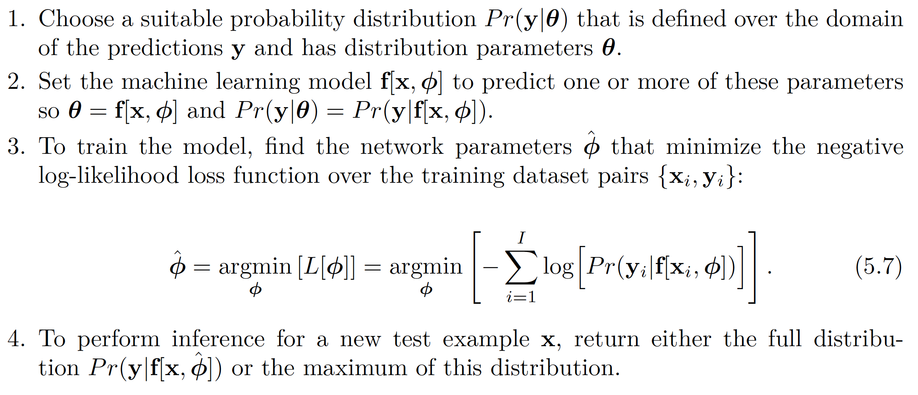
Recipe for loss functions

Slide 50
Loss functions
Maximum likelihood
Recipe for loss functions
Example 1: univariate regression
Example 2: binary classification
Example 3: multiclass classification
Other types of data
Multiple outputs
Cross entropy

Slide 51
Example 1: univariate regression

Slide 52

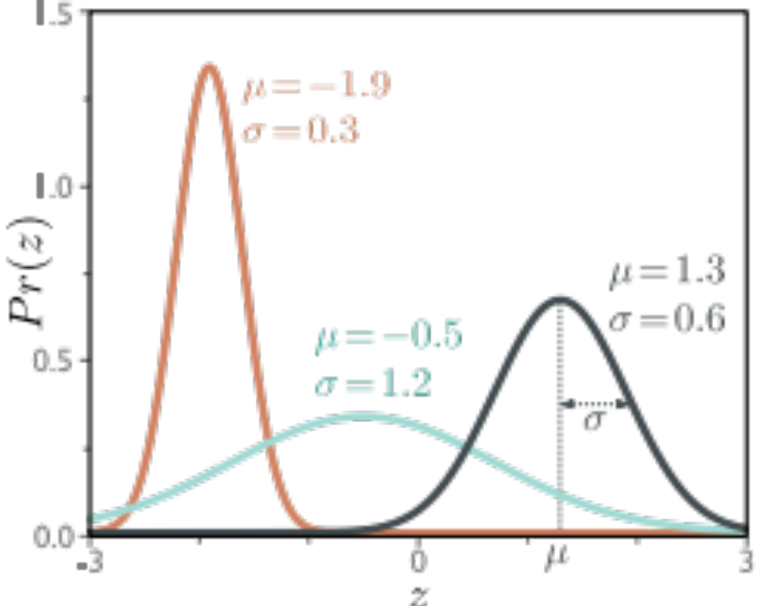
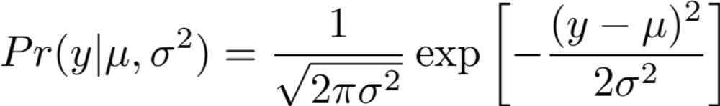
Example 1: univariate regression
Predict scalar output:
Sensible probability distribution:
  Normal distribution

Slide 53
Example 1: univariate regression
Predict scalar output:
Sensible probability distribution:
  Normal distribution

Slide 54
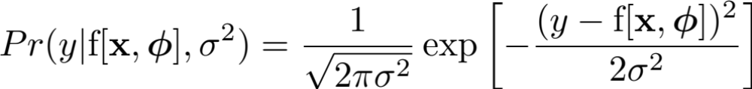
Example 1: univariate regression

Slide 55
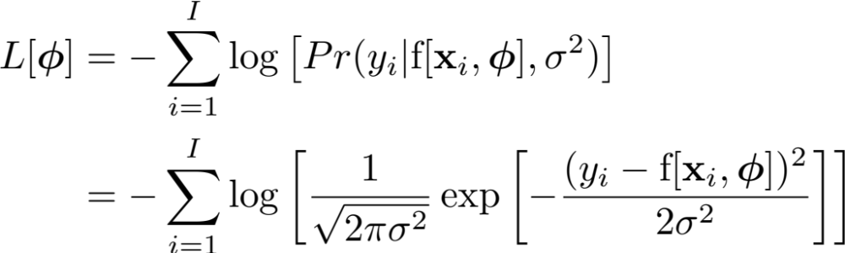
Example 1: univariate regression

Slide 56
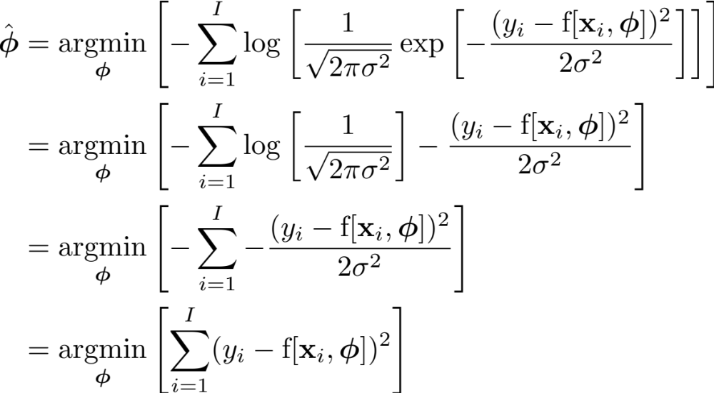
Example 1: univariate regression

Slide 57
Example 1: univariate regression
Least squares!

Slide 58
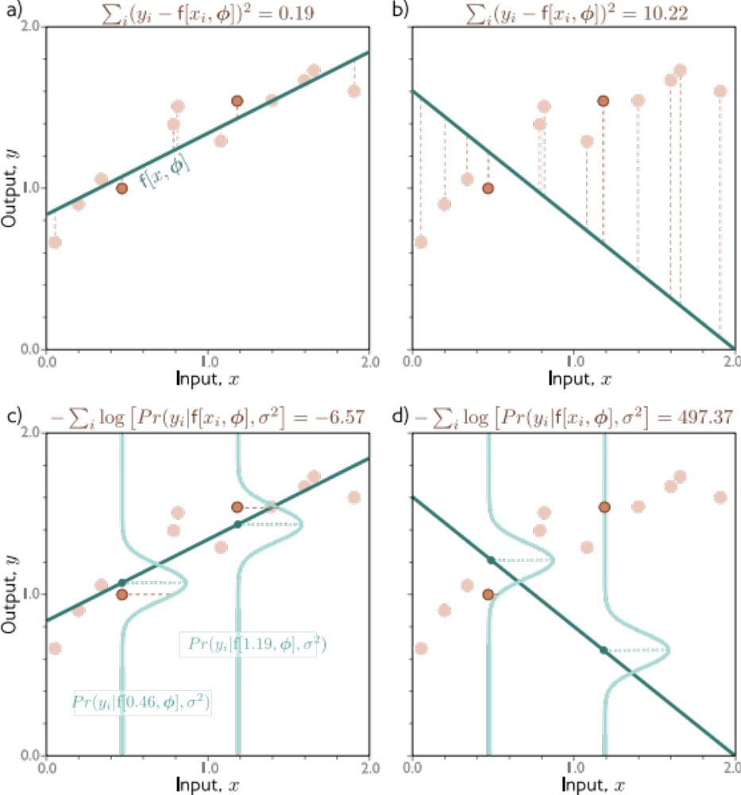
Least squares
Maximum likelihood

Slide 59
Least squares
Maximum likelihood

Slide 60
Example 1: univariate regression

Slide 61
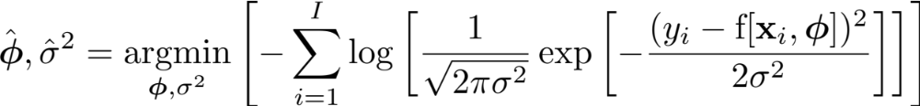
Estimating variance
Perhaps surprisingly, the variance term disappeared:
But we could learn it:

Slide 62
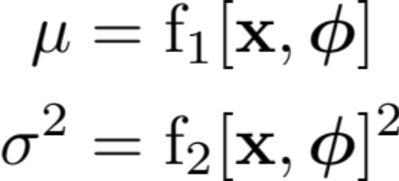
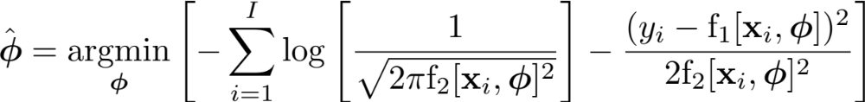
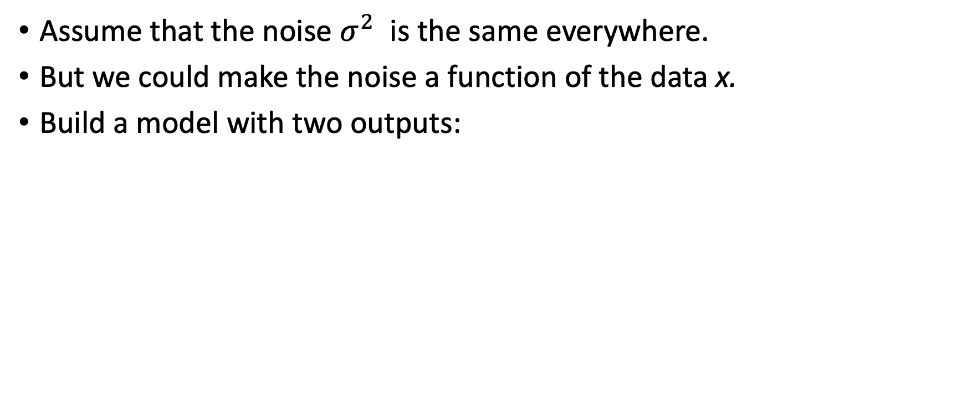
Heteroscedastic regression
Assume that the noise $σ^{2}$ is the same everywhere.
But we could make the noise a function of the data x.
Build a model with two outputs:

Slide 63
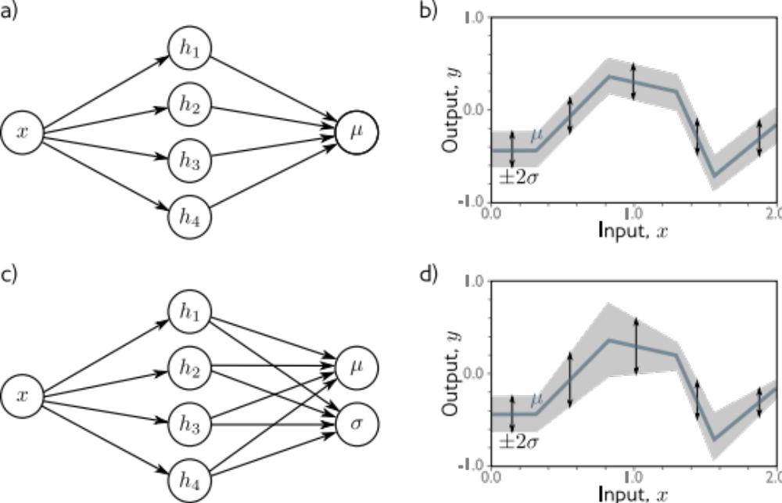
Heteroscedastic regression

Slide 64
Loss functions
Maximum likelihood
Recipe for loss functions
Example 1: univariate regression
Example 2: binary classification
Example 3: multiclass classification
Other types of data
Multiple outputs
Cross entropy

Slide 65

Example 2: binary classification
Goal: predict which of two classes the input x belongs to

Slide 66
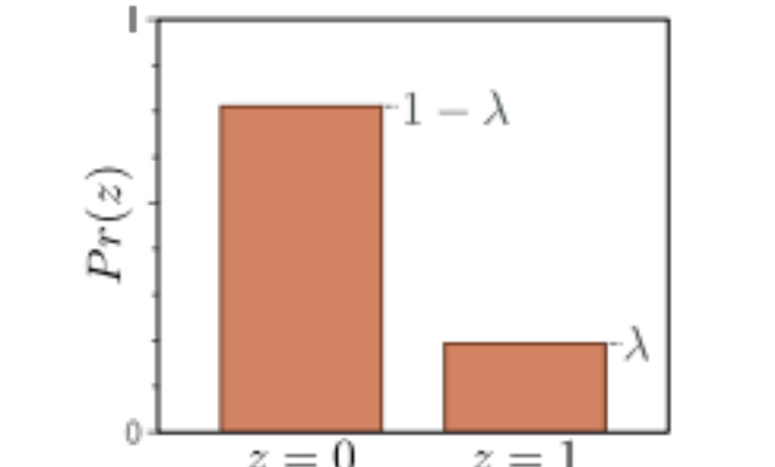



Example 2: binary classification
Domain:
Bernoulli distribution
One parameter $λ∈$[0,1]

Slide 67

Example 2: binary classification
Problem:
  Output of neural network can be anything
  Parameter $λ∈$[0,1]
Solution:
  Pass through function that maps “anything to [0,1]

Slide 68



Example 2: binary classification
Problem:
  Output of neural network can be anything
  Parameter $λ∈$[0,1]
Solution:
  Pass through logistic sigmoid function that maps “anything to [0,1]:

Slide 69
Example 2: binary classification

Slide 70

Example 2: binary classification

Slide 71


Example 2: binary classification
*Binary cross-entropy loss*

Slide 72

Example 2: binary classification
Choose y=1 where $λ$ is greater than 0.5, otherwise 1

Slide 73
Loss functions
Maximum likelihood
Recipe for loss functions
Example 1: univariate regression
Example 2: binary classification
Example 3: multiclass classification
Other types of data
Multiple outputs
Cross entropy

Slide 74


Example 3: multiclass classification
Goal: predict which of K classes the input x belongs to

Slide 75



Example 3: multiclass classification
Domain:
Categorical distribution
K parameters $λ_{k}∈$[0,1]
Sum of all parameters = 1

Slide 76


Example 3: multiclass classification
Problem:
  Output of neural network can be anything
  Parameters $λ_{k}∈$[0,1], sum to one
Solution:
  Pass through function that maps “anything” to [0,1], sum to one

Slide 77

Example 3: multiclass classification

Slide 78


Example 3: multiclass classification
*Multiclass cross-entropy loss*

Slide 79

Example 3: multiclass classification
Choose the class with the largest probability

Slide 80
Loss functions
Maximum likelihood
Recipe for loss functions
Example 1: univariate regression
Example 2: binary classification
Example 3: multiclass classification
Other types of data
Multiple outputs
Cross entropy

Slide 81

Other data types

Slide 82
Loss functions
Maximum likelihood
Recipe for loss functions
Example 1: univariate regression
Example 2: binary classification
Example 3: multiclass classification
Other types of data
Multiple outputs
Cross entropy

Slide 83



Multiple outputs
Treat each output as independent:
Negative log likelihood becomes sum of terms:

Slide 84
Example 4: multivariate regression

Slide 85




Example 4: multivariate regression
Goal: to predict a multivariate target
Solution treat each dimension independently
Make network with $D_{o}$ outputs to predict means

Slide 86
Example 4: multivariate regression
What if the outputs vary in magnitude
  E.g., predict weight in kilos and height in meters
  One dimension has much bigger numbers than others
Could learn a separate variance for each…
…or rescale before training, and then rescale output in opposite way

Slide 87
Loss functions
Maximum likelihood
Recipe for loss functions
Example 1: univariate regression
Example 2: binary classification
Example 3: multiclass classification
Other types of data
Multiple outputs
Cross entropy

Slide 88


Cross Entropy
Kullback-Leibler Divergence -- a measure between probability distributions

Slide 89

Cross Entropy
Kullback-Leibler Divergence -- a measure between probability distributions

Slide 90

Cross Entropy

Slide 91

Cross Entropy
Minimum negative log likelihood

Slide 92

Cross entropy in machine learning
Minimum negative log likelihood
In machine learning:

Slide 93
Next up
We have models with parameters!
We have loss functions!
Now let’s find the parameters that give the smallest loss
  Training, learning, or fitting the model

