Slide 1
Deep Learning
Supervised learning
  Tasks
  Models
  Deep learning models
Unsupervised learning
  Generative models
  Probabilistic generative models
  Latent variable models
Reinforcement learning

Slide 2
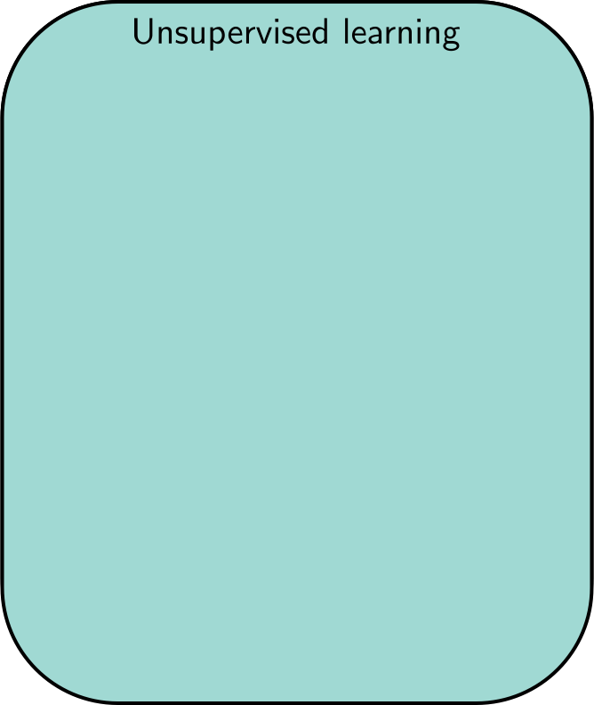
Unsupervised Learning
Learning about a dataset without labels
  e.g., clustering

Slide 3
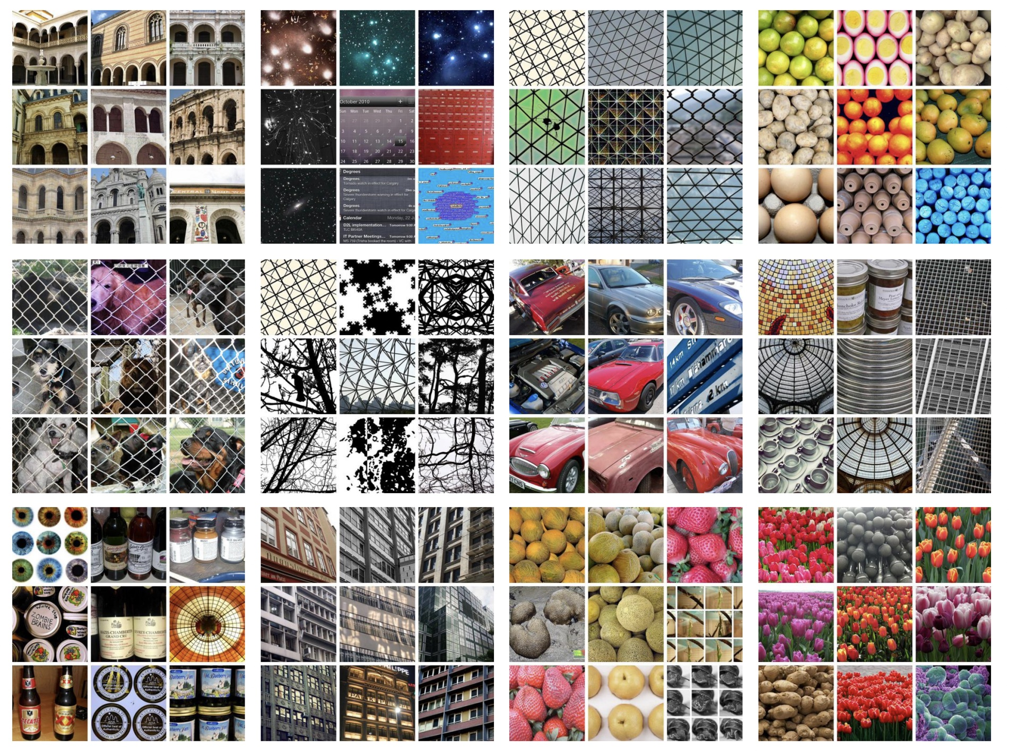
DeepCluster: Deep Clustering for Unsupervised Learning of Visual Features
Caron et al. (2018)

Slide 4
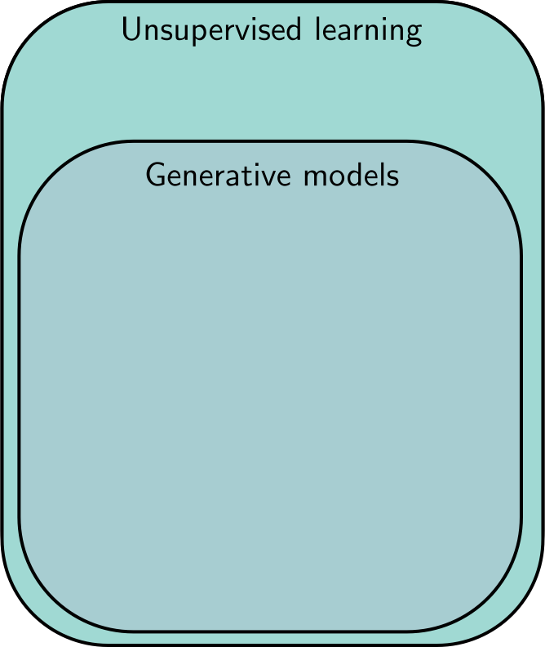
Unsupervised Learning
Learning about a dataset without labels
  e.g., clustering
Generative models can create examples
  e.g., generative adversarial networks

Slide 5
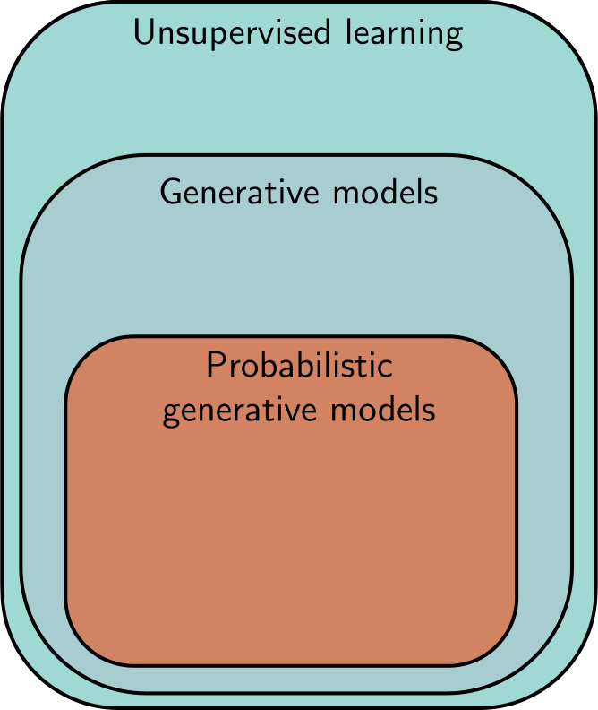
Unsupervised Learning
Learning about a dataset without labels
  e.g., clustering
Generative models can create examples
  e.g., generative adversarial networks
PGMs learn distribution over data
  e.g., variational autoencoders,
  e.g., normalizing flows,
  e.g., diffusion models

Slide 6
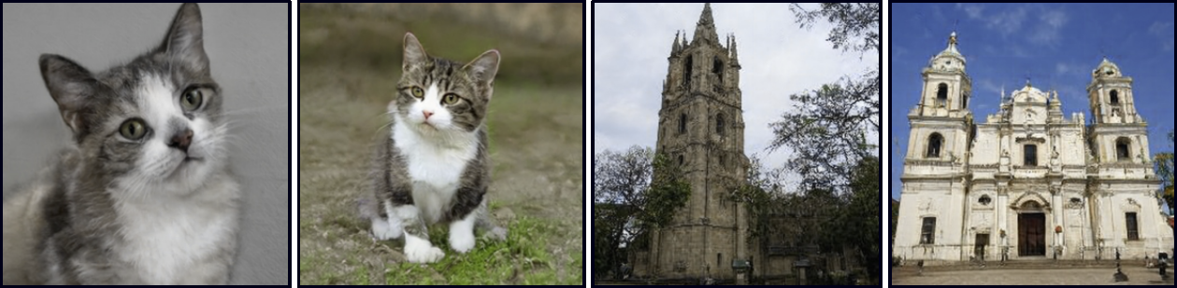
Synthesis

Slide 7
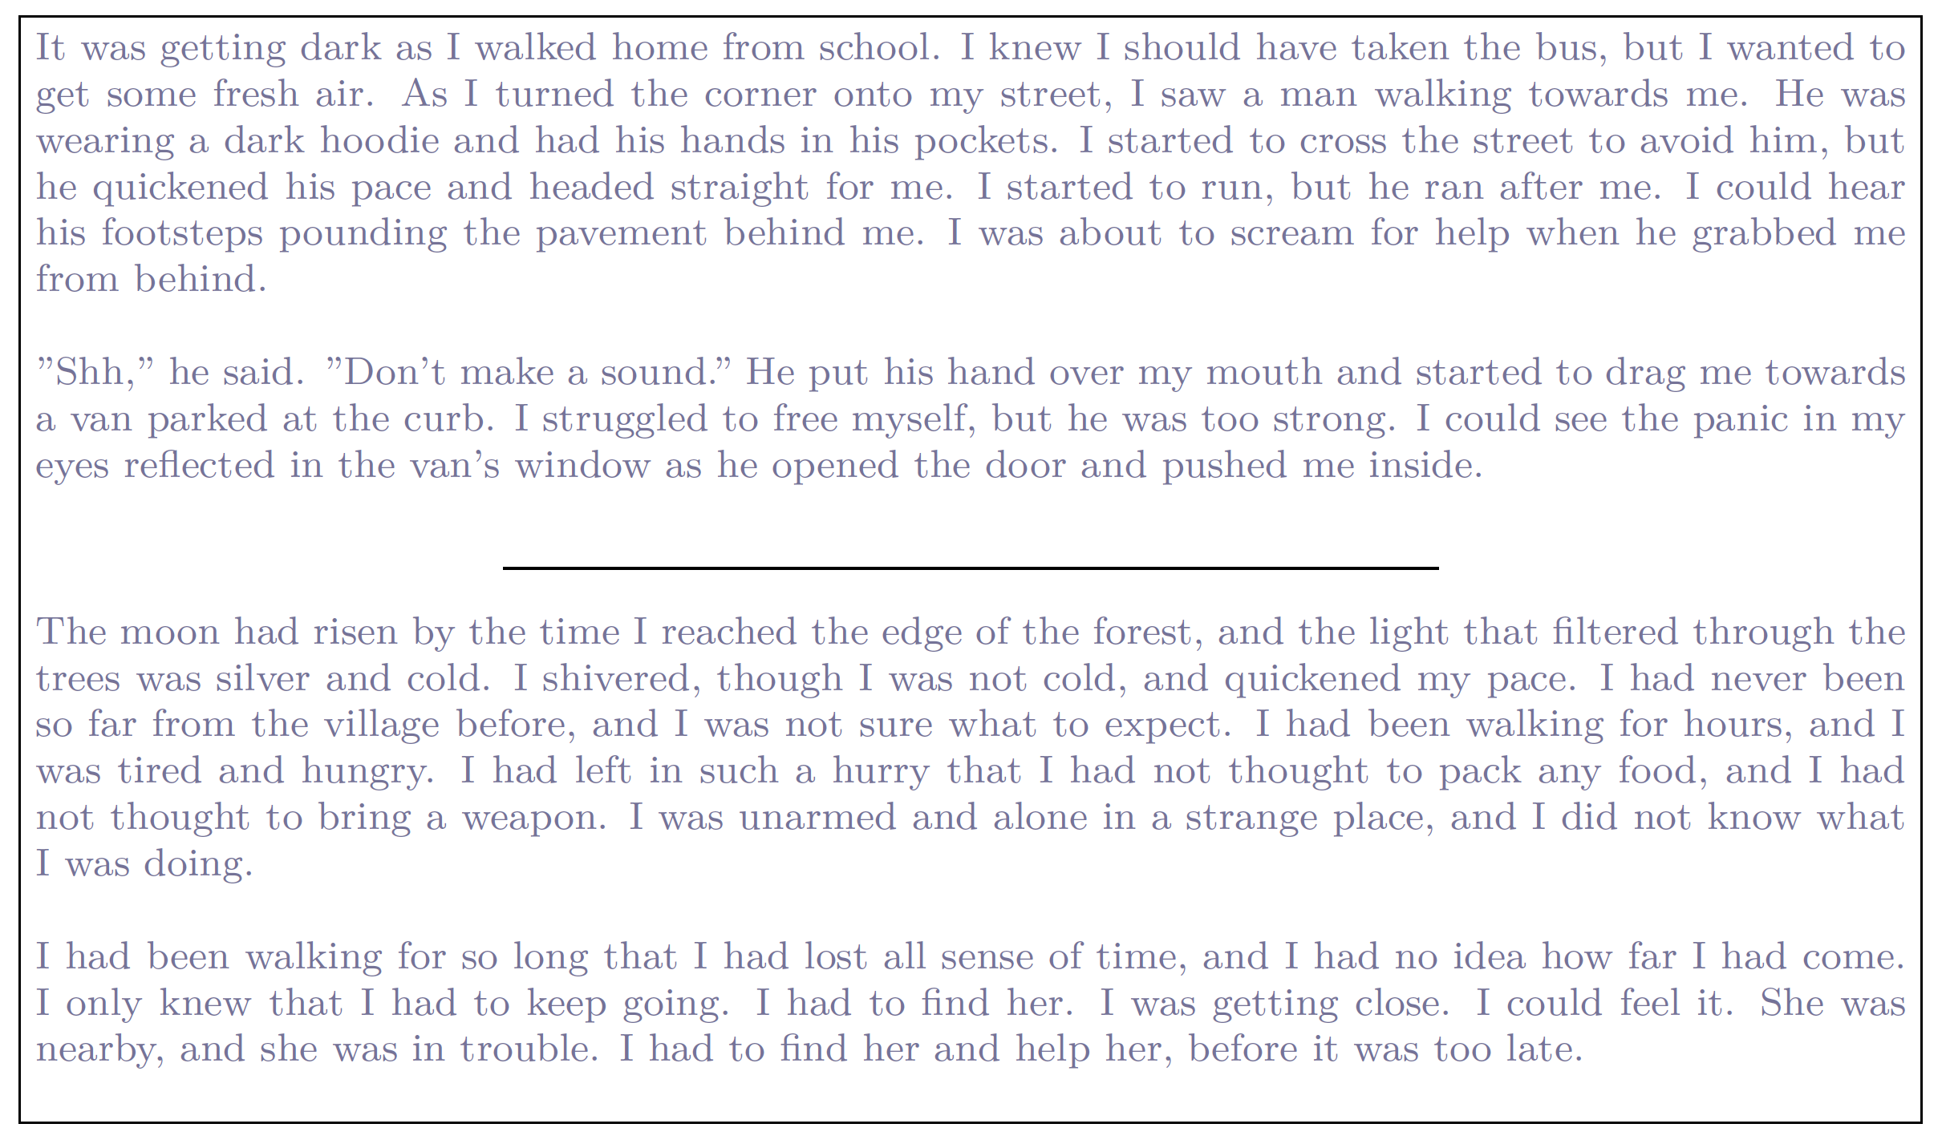
Synthesis

Slide 8
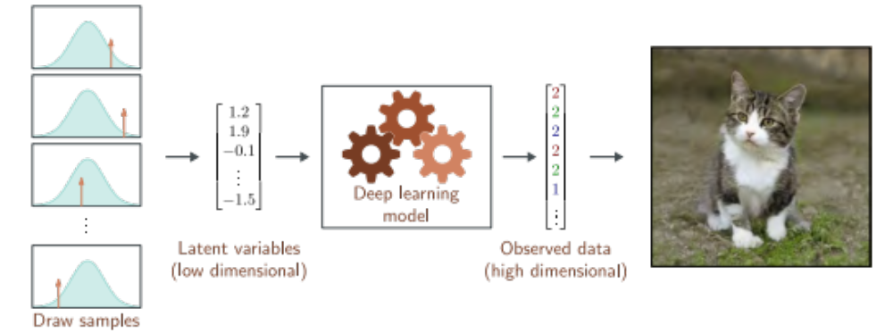
Latent variables

Slide 9

Why latent variables work

Slide 10
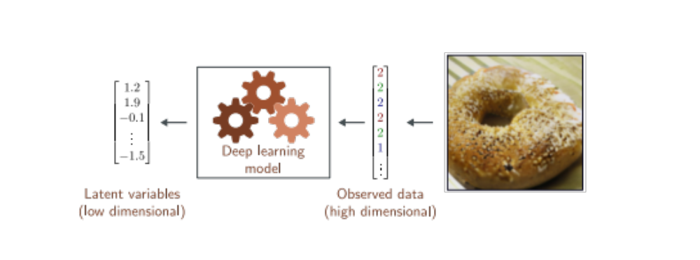
Latent variables - inversion

Slide 11
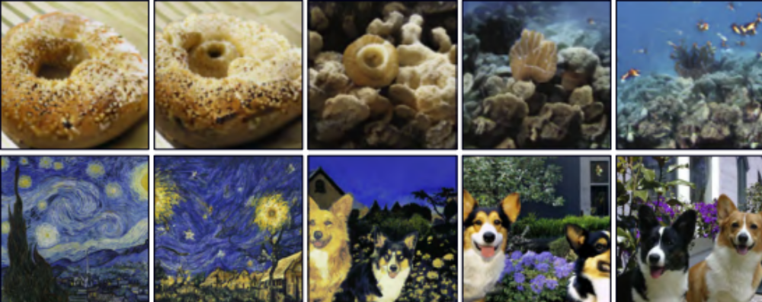
Interpolation

Slide 12
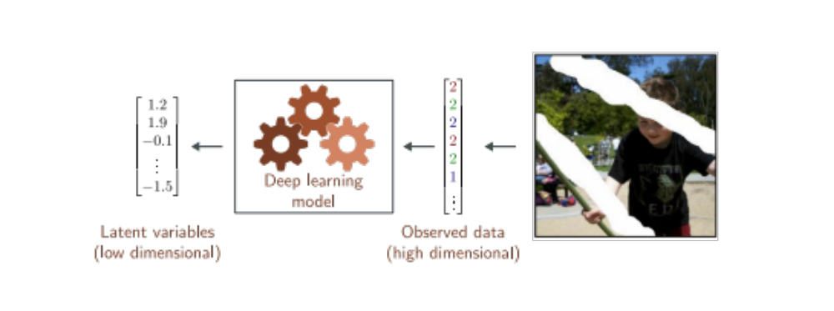
Latent variables - Inversion

Slide 13
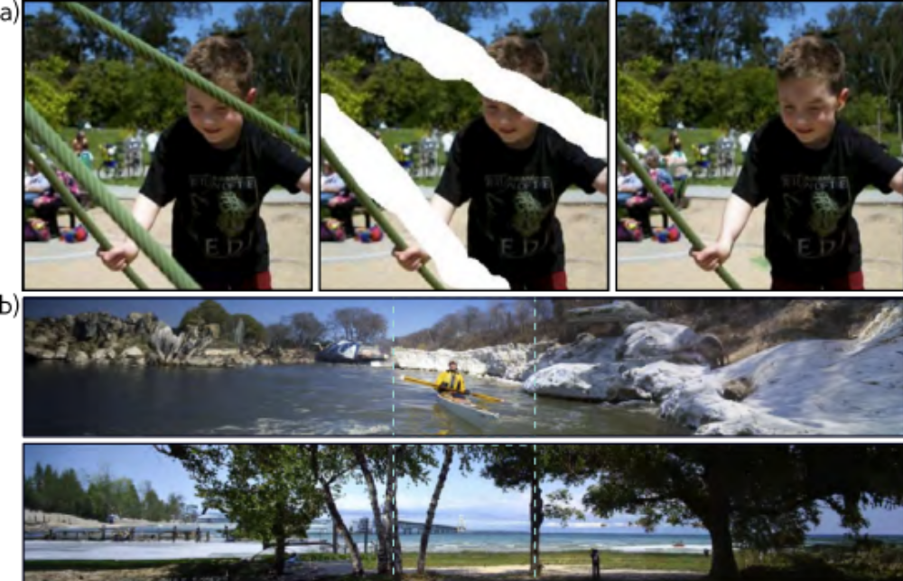
Conditional synthesis

Slide 14
Conditional synthesis

Slide 15
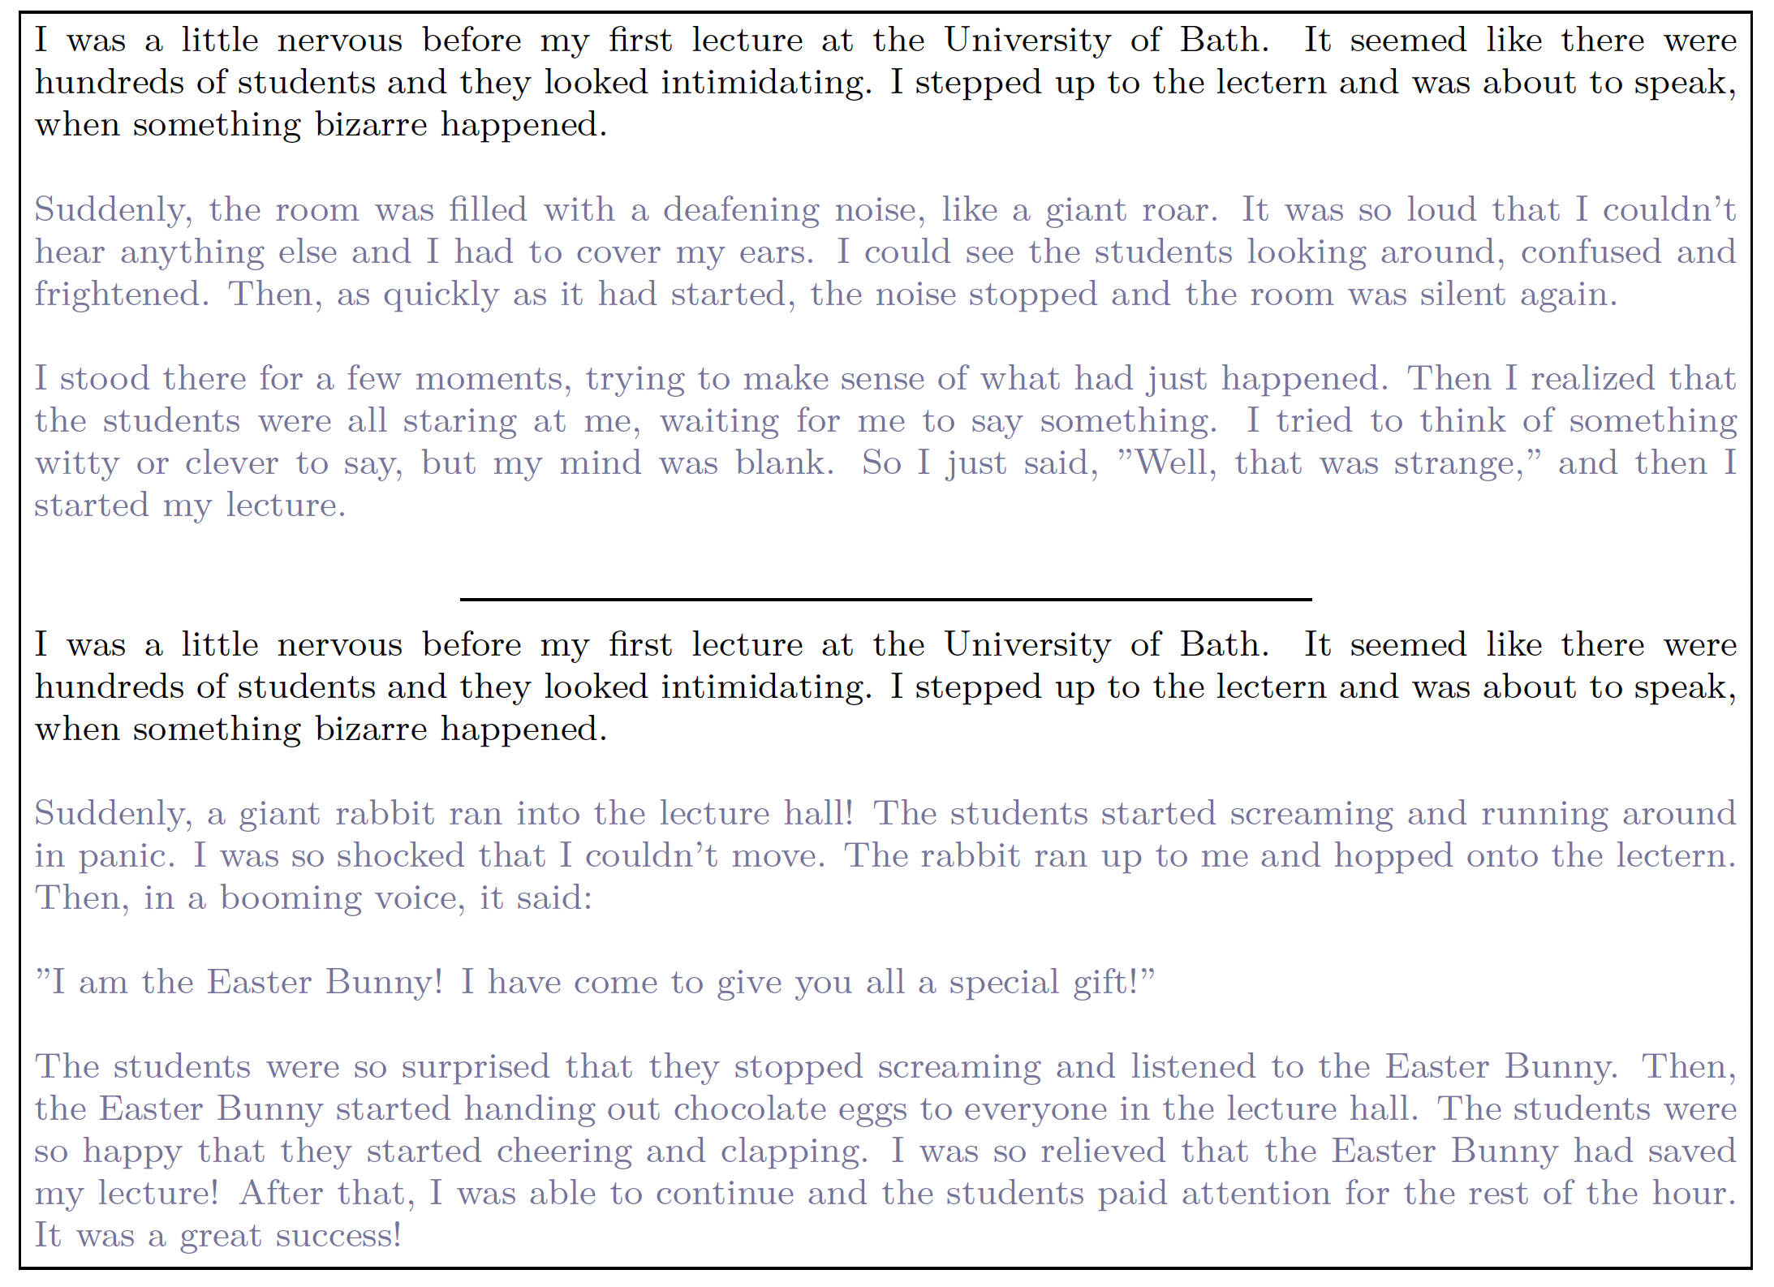

Slide 16
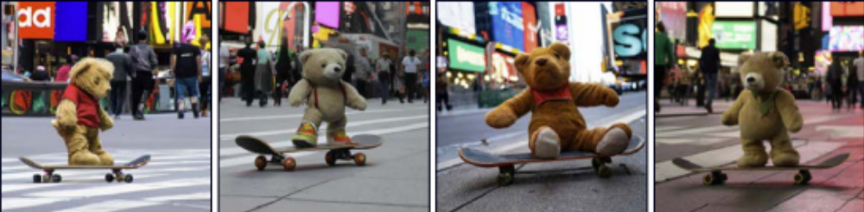
Connecting to supervised learning
A teddy bear on a skateboard in times square

Slide 17
Deep Learning
Supervised learning
  Tasks
  Models
  Deep learning models
Unsupervised learning
  Generative models
  Probabilistic generative models
  Latent variable models
Reinforcement learning

Slide 18
Reinforcement learning
A set of states
A set of actions
A set of rewards
Goal: take actions to change the state so that you receive rewards
  Technically “Expected discounted future rewards”
e.g., chess
  States are valid states of the chess board
  Actions at a given time are valid possible moves
  Positive rewards for taking pieces, negative rewards for losing them

Slide 19
Why is this difficult?
Stochastic
  Make the same move twice, the opponent might not do the same thing
  Rewards also stochastic (opponent does or doesn’t take your piece)
Temporal credit assignment problem
  Did we get the reward because of this move? Or because we made good tactical decisions somewhere in the past?
Exploration-exploitation trade-off
  If we found a good opening, should we use this?
  Or should we try other things, hoping for something better?

Slide 20
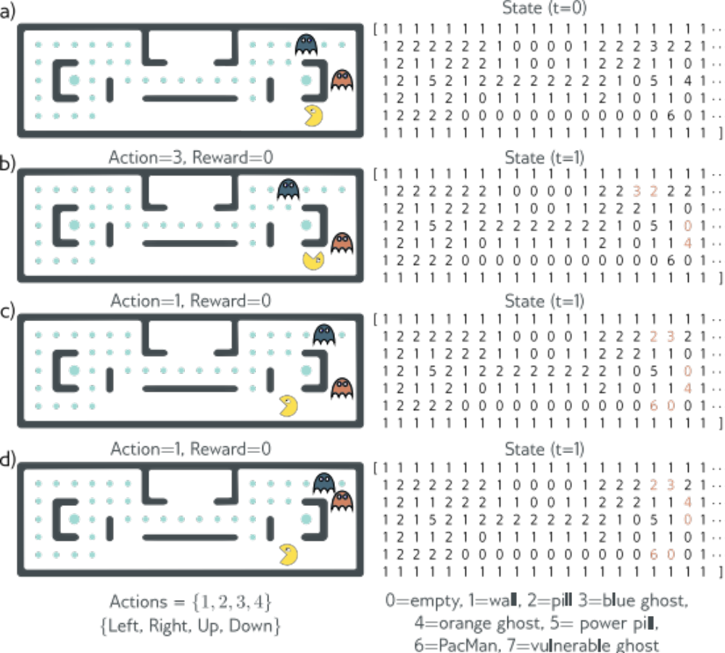
Pacman example

Slide 21
Pacman example

Slide 22
Pacman example

Slide 23
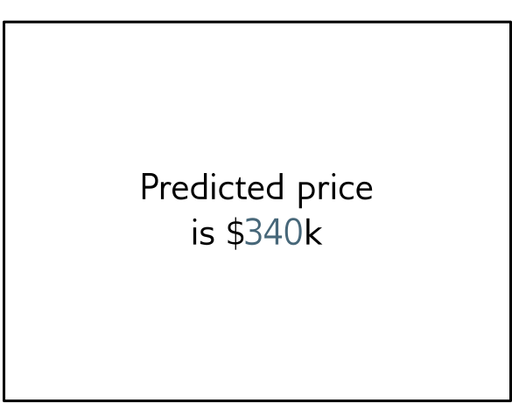
Policy learning
Action is move downward

Slide 24
Deep Learning
Supervised learning
  Tasks
  Models
  Deep learning models
Unsupervised learning
  Generative models
  Probabilistic generative models
  Latent variable models
Reinforcement learning

Slide 25
MAKE A GOOGLE/GMAIL ACCOUNT!

