Slide 1


CM20315 - Machine Learning
Prof. Simon Prince
5a. Catchup

Slide 2
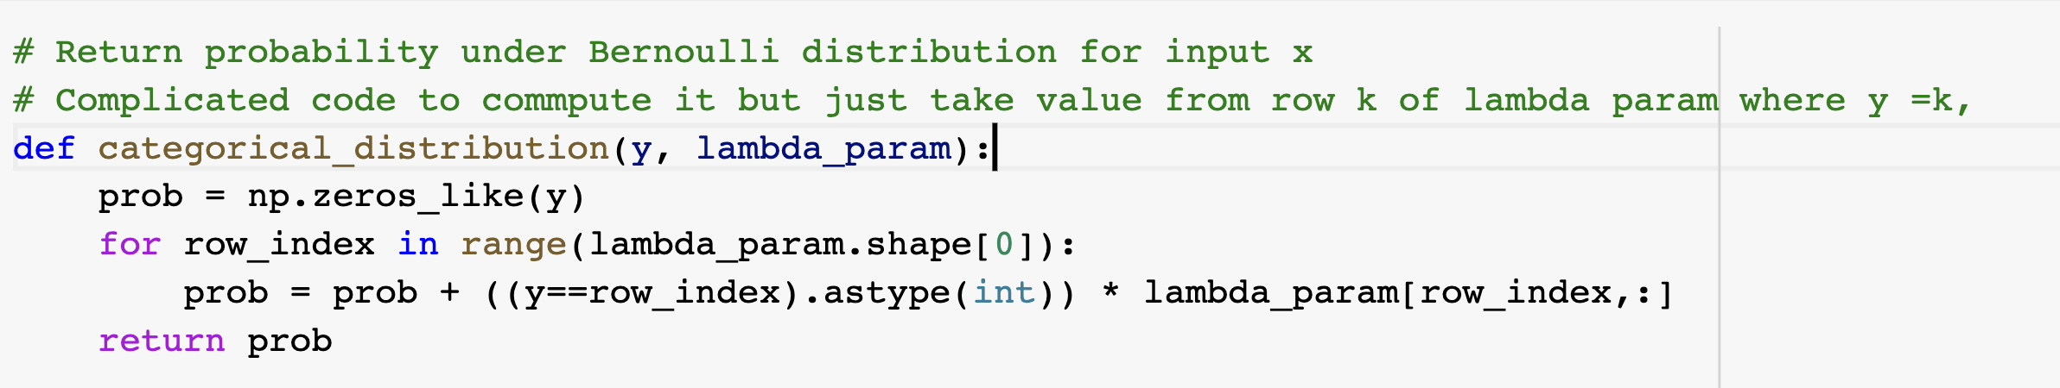
Mysterious code

Slide 3
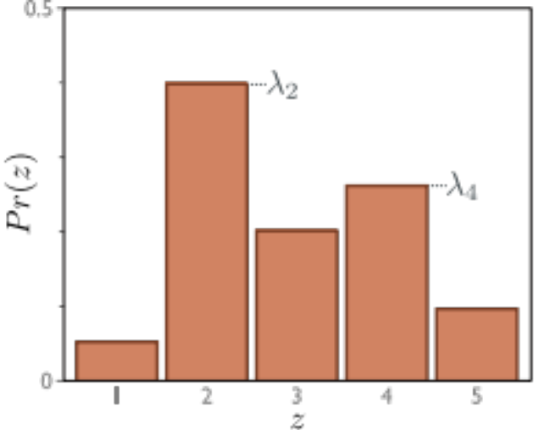

Mysterious code

Slide 4
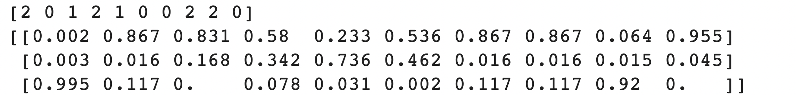
Mysterious code

Slide 5
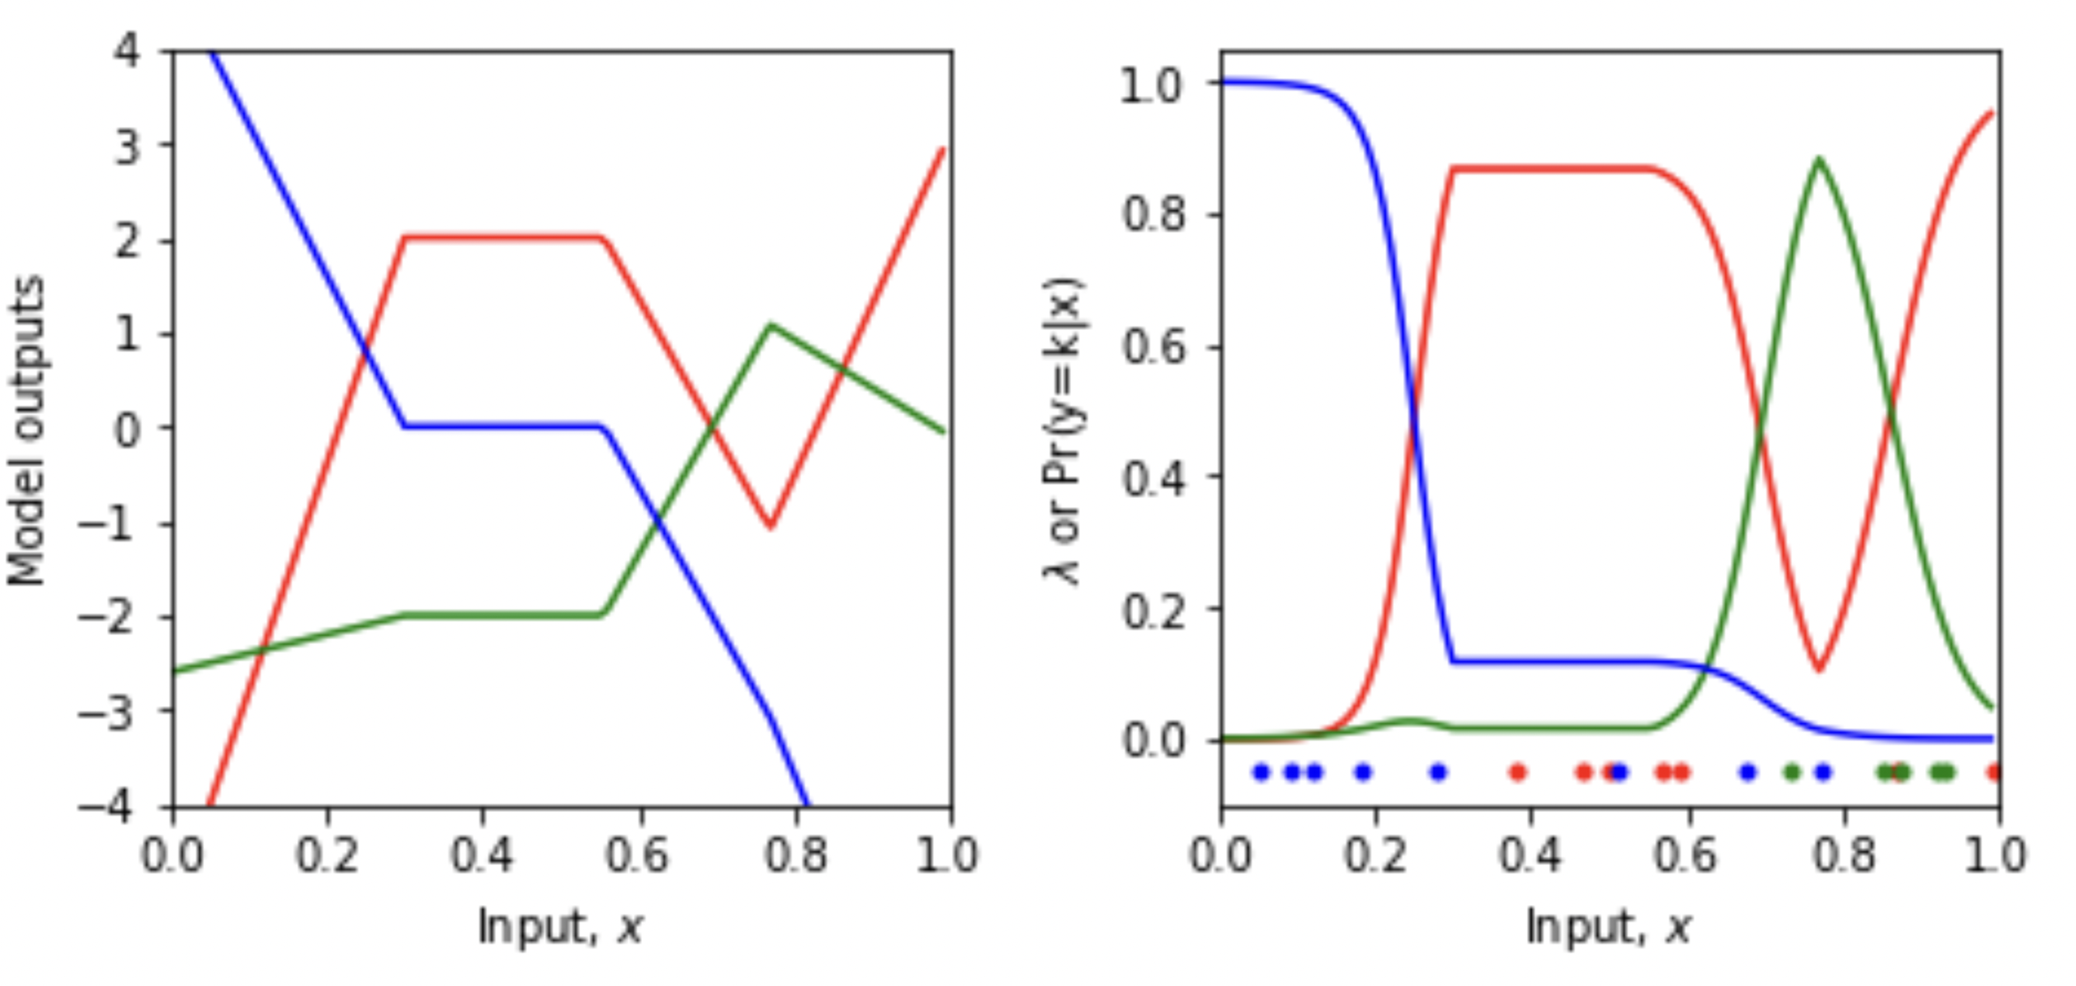

Slide 6
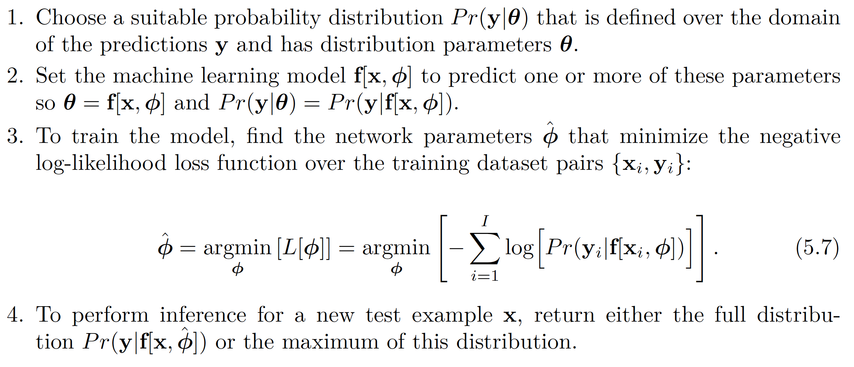
Recipe for loss functions

Slide 7
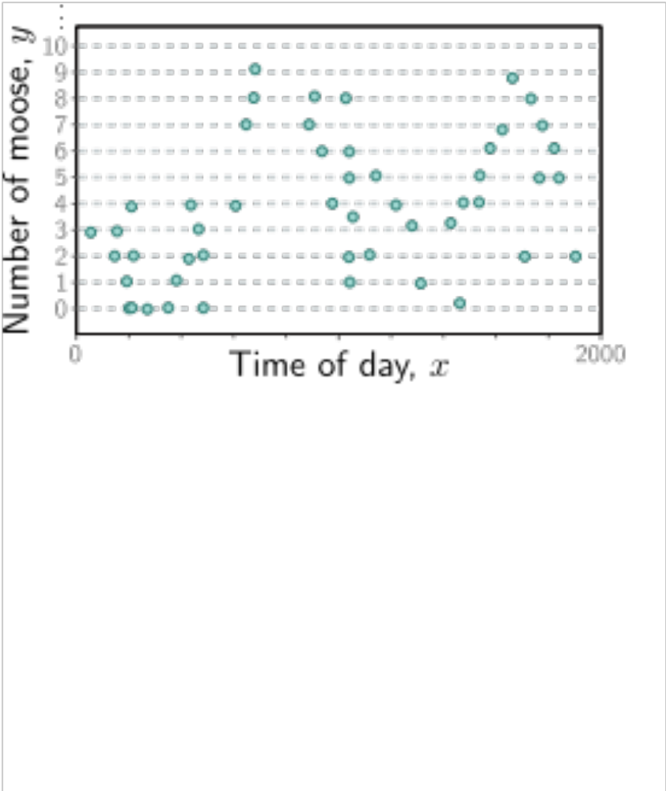

Slide 8
Recipe for loss functions

Slide 9
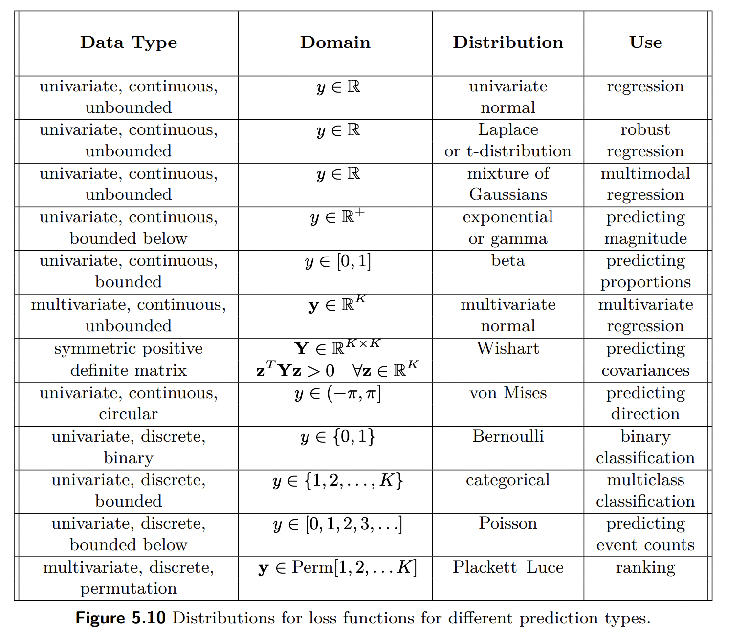

Slide 10
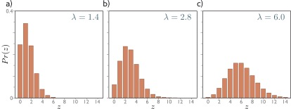
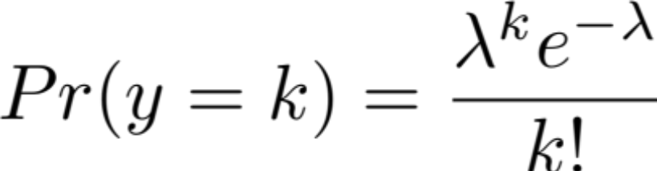

Poisson distribution

Slide 11
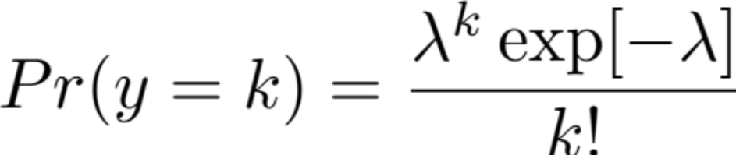
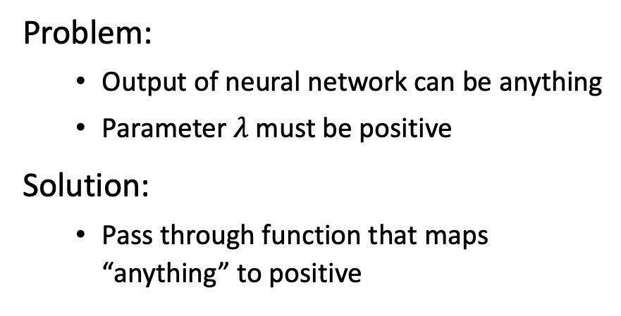
Problem:
  Output of neural network can be anything
  Parameter $λ$must be positive
Solution:
  Pass through function that maps “anything” to positive

Slide 12

Problem:
  Output of neural network can be anything
  Parameter $λ$must be positive
Solution:
  Pass through function that maps “anything” to positive

Slide 13
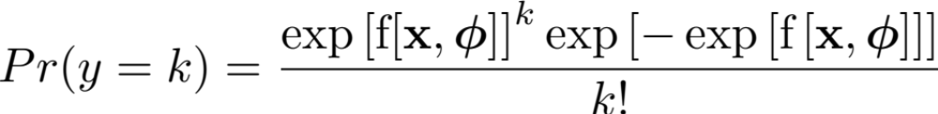

Slide 14
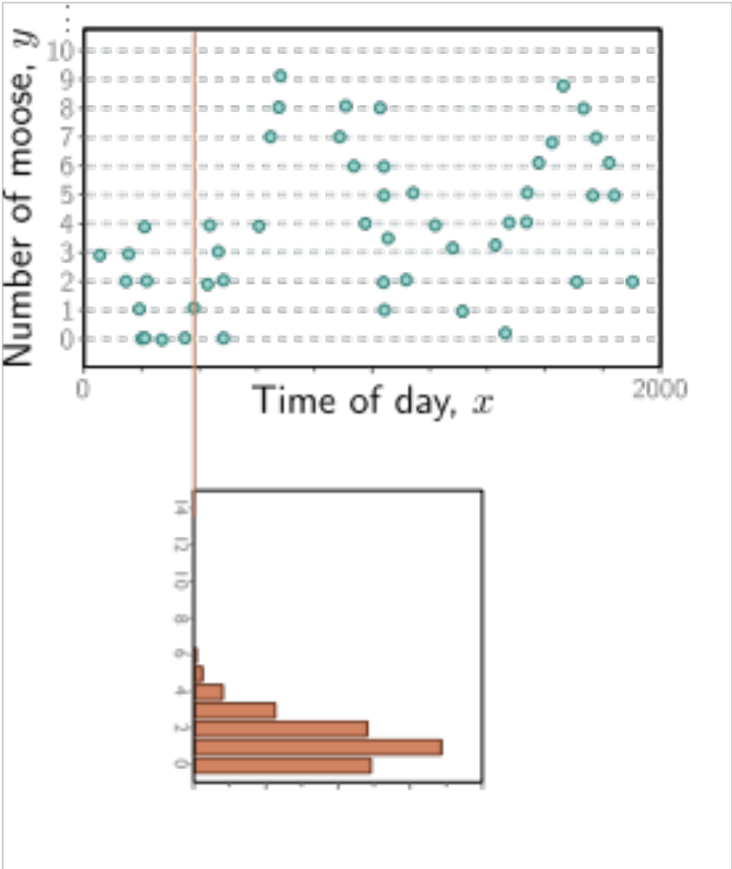

Slide 15
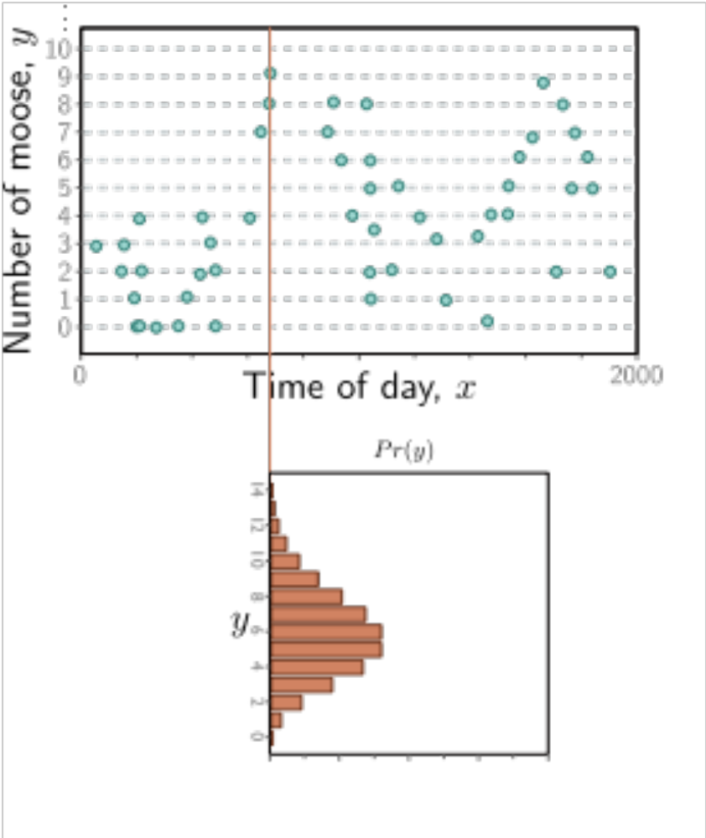

Slide 16
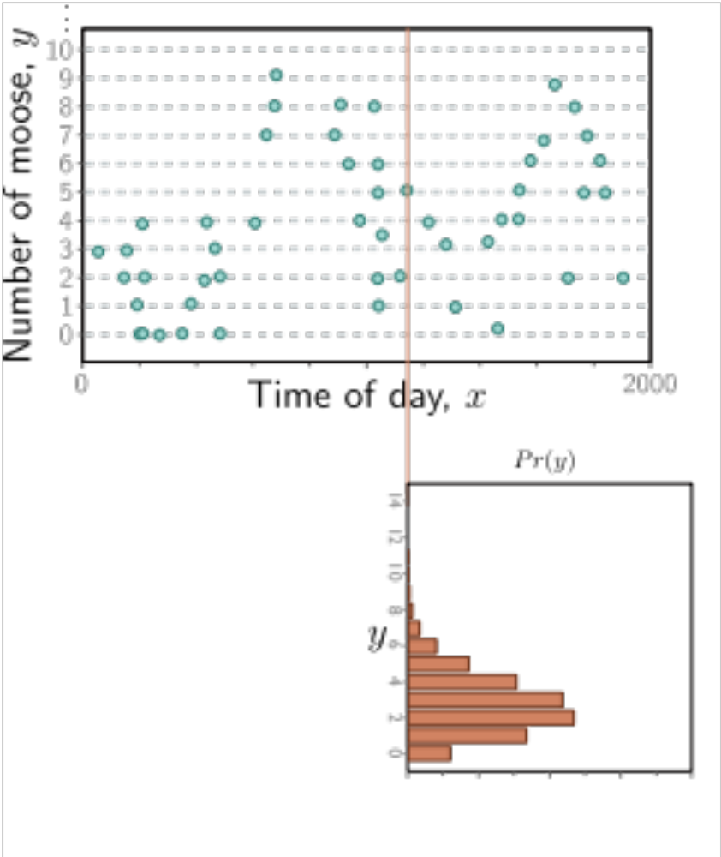

Slide 17
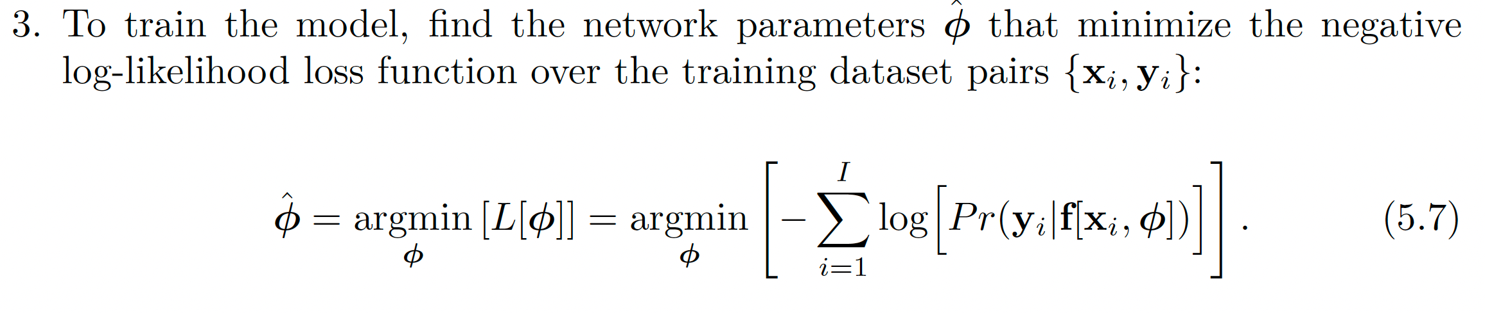

Slide 19
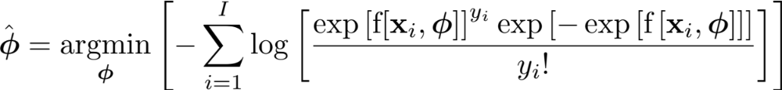

Slide 20
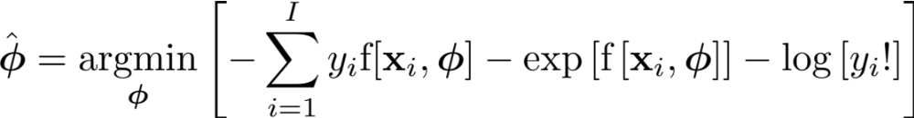

Slide 22
Recipe for loss functions

Slide 23
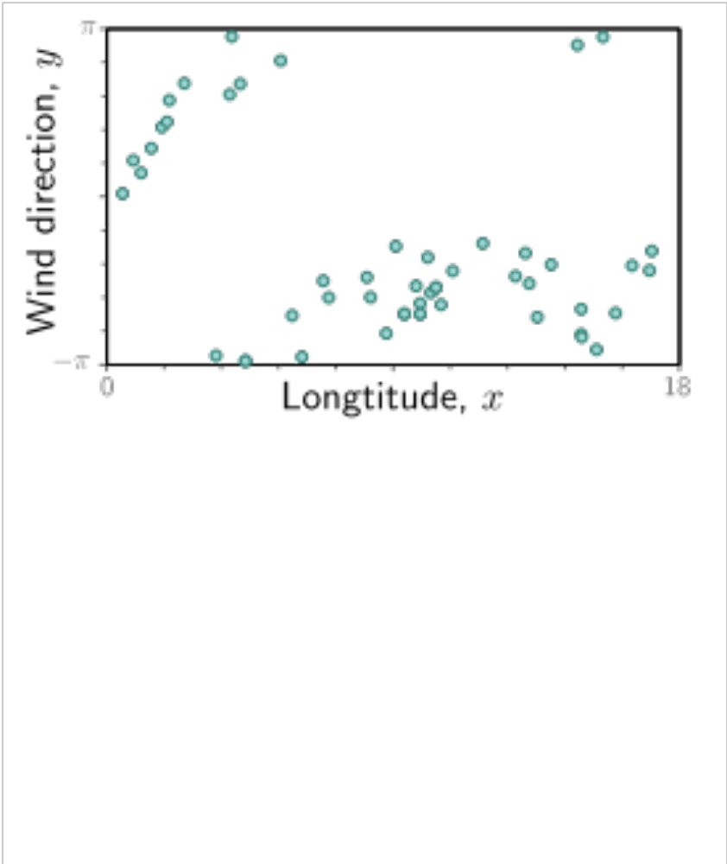

Slide 24
Recipe for loss functions

Slide 26
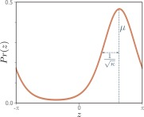
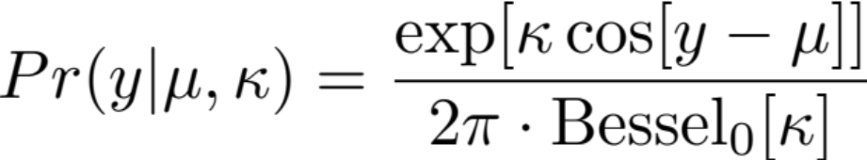


Von Mises distribution

Slide 28
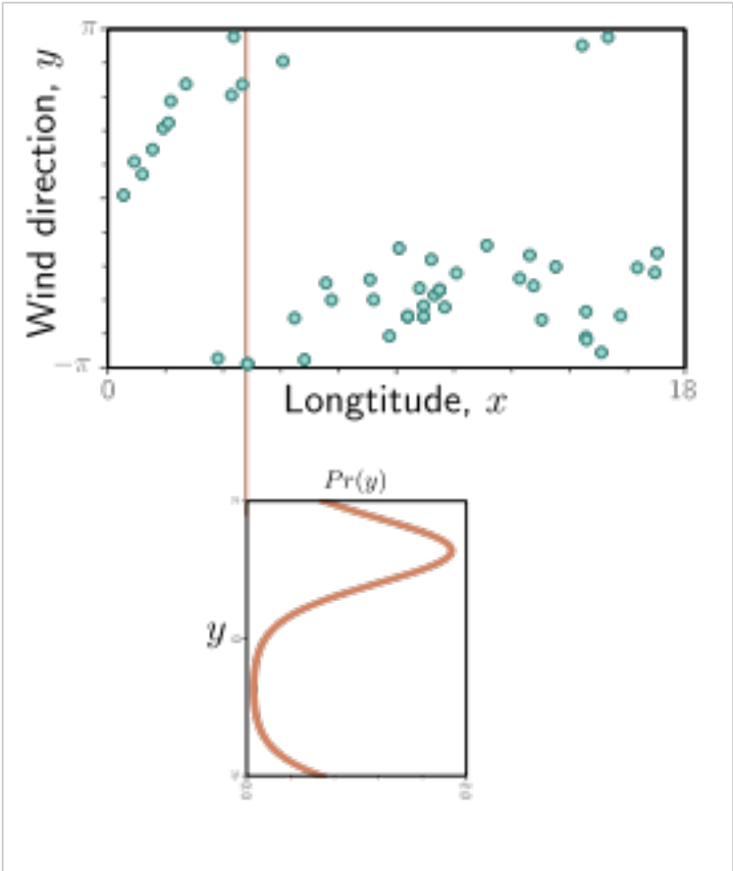

Slide 31


Model
Parameters:
Model :
Parameters always Greek letters

Slide 32
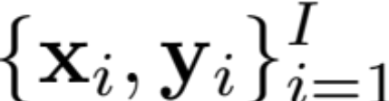
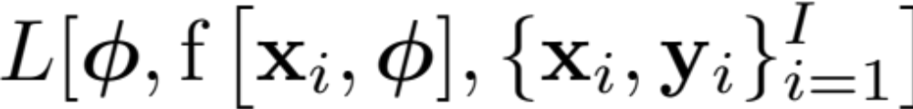

Loss function
Training dataset of I pairs of input/output examples:
Loss function or cost function measures how bad model is:
or for short:
Returns a scalar that is smaller when model maps inputs to outputs better

Slide 33
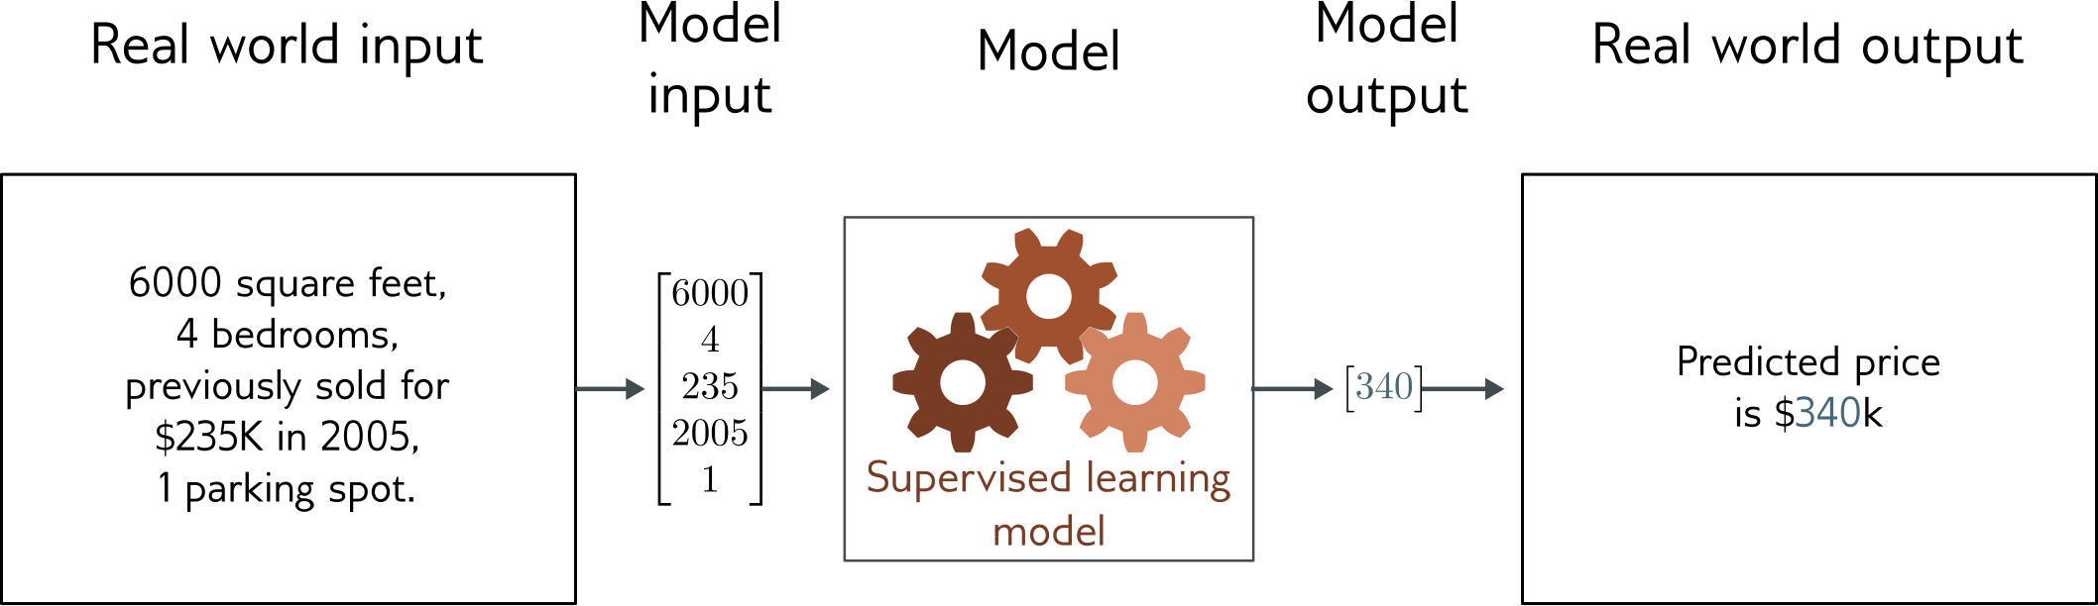
Regression
Univariate regression problem (one output, real value)
Fully connected network

Slide 34
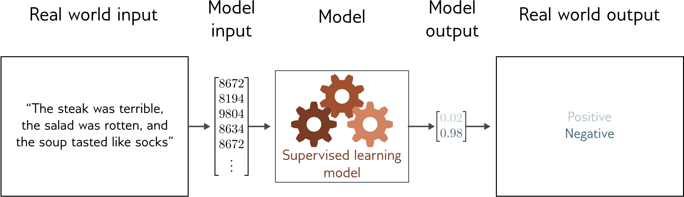
Text classification
Binary classification problem (two discrete classes)
Transformer network

Slide 35
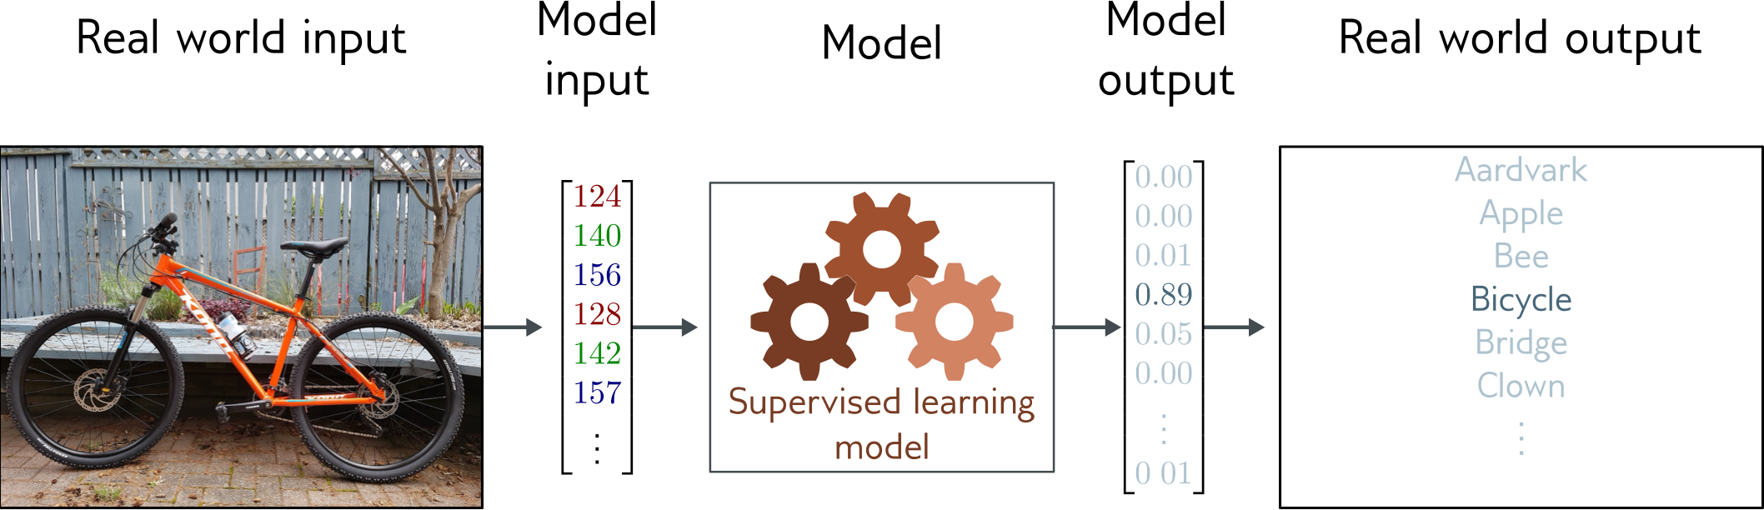
Image classification
Multiclass classification problem (discrete classes, >2 possible classes)
Convolutional network

Slide 36
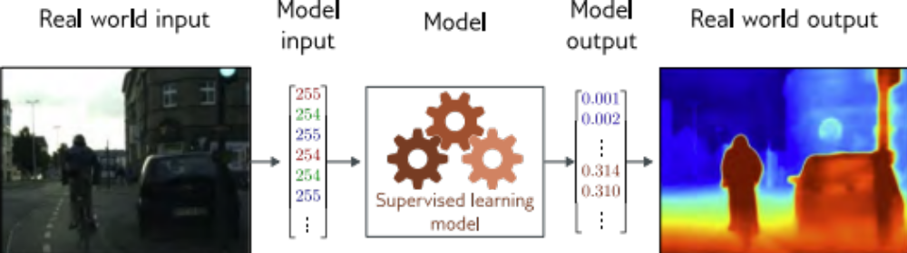
Depth estimation
Multivariate regression problem (many outputs, continuous)
Convolutional encoder-decoder network

Slide 37
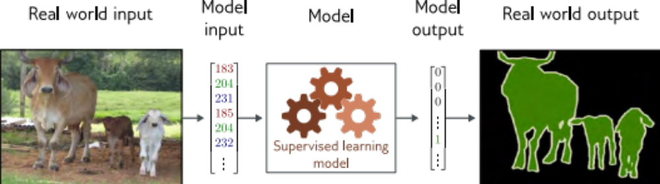
Image segmentation
Multivariate binary classification problem (many outputs, two discrete classes)
Convolutional encoder-decoder network

Slide 38
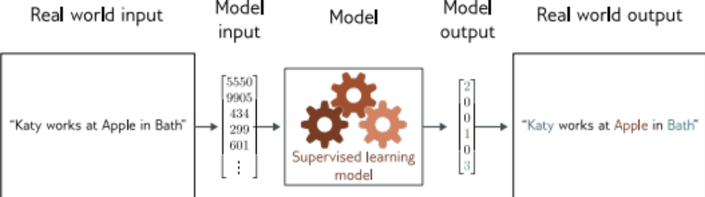
Entity classification
Multivariate multiclass classification
Transformer network

Slide 39
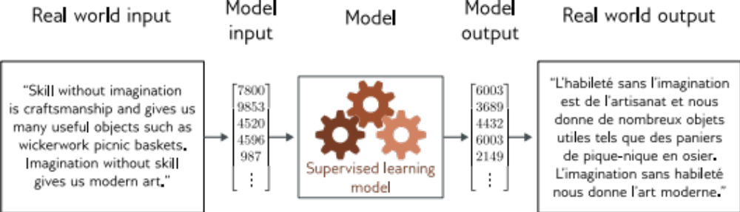
Translation

Slide 40
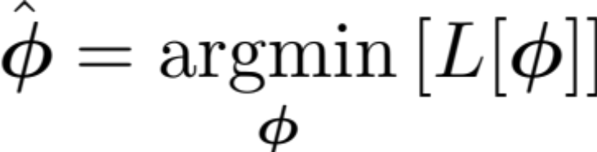
Training
Loss function:
Find the parameters that minimize the loss:
Returns a scalar that is smaller when model maps inputs to outputs better

Slide 41
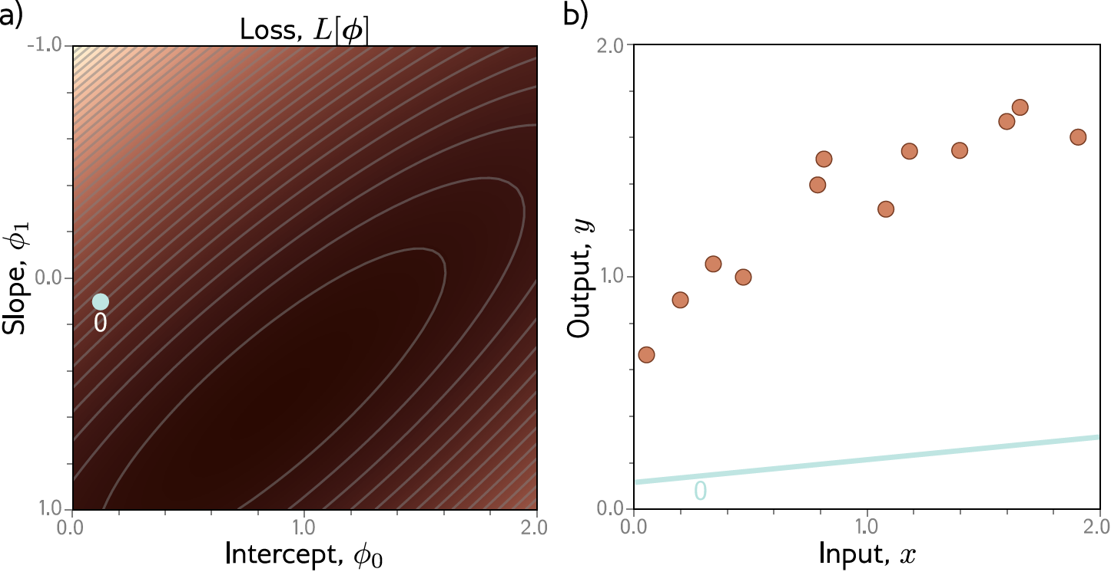
Example: 1D Linear regression training

Slide 42
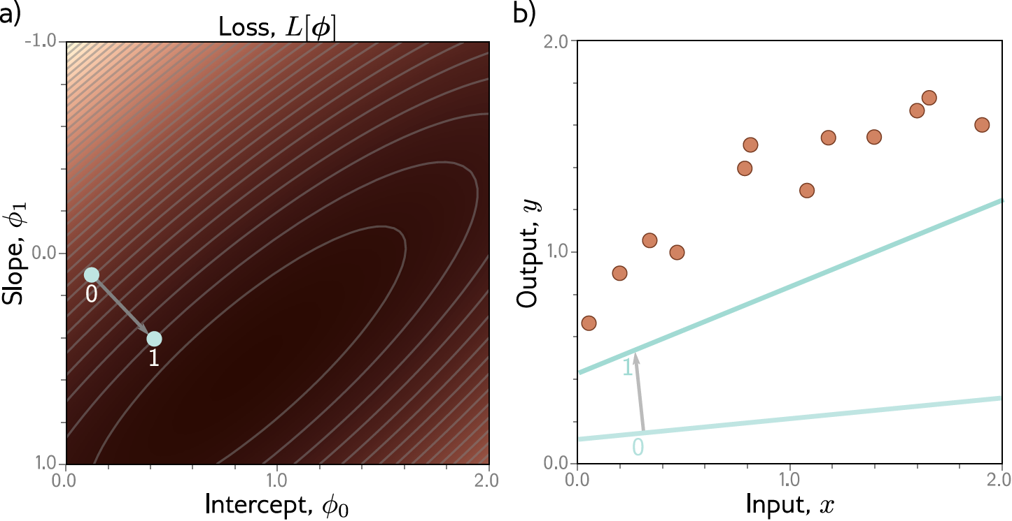
Example: 1D Linear regression training

Slide 43
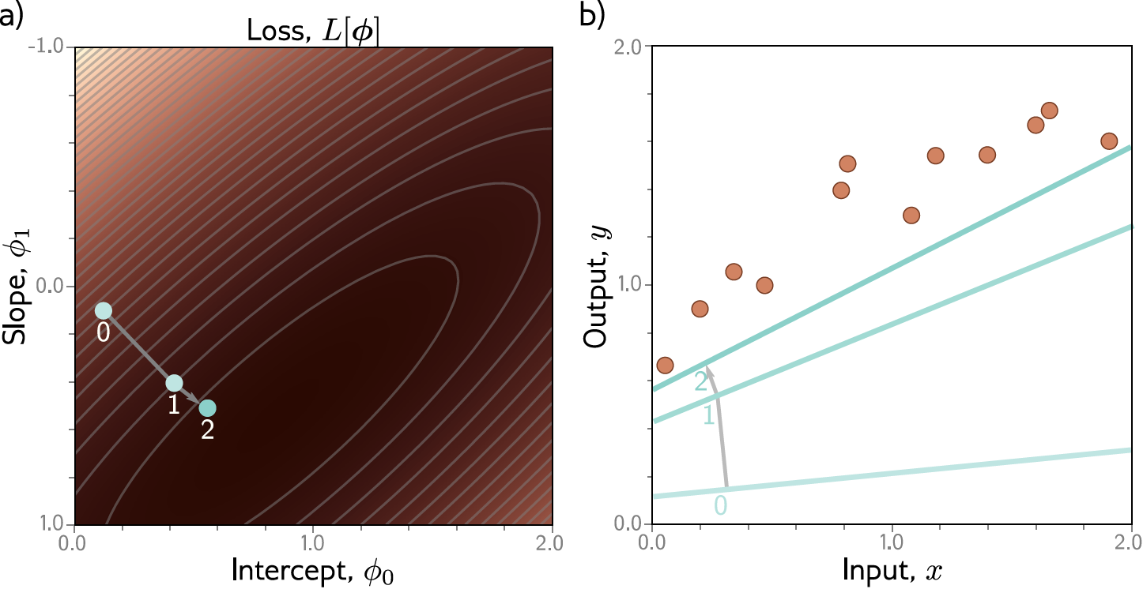
Example: 1D Linear regression training

Slide 44

Example: 1D Linear regression training

Slide 45
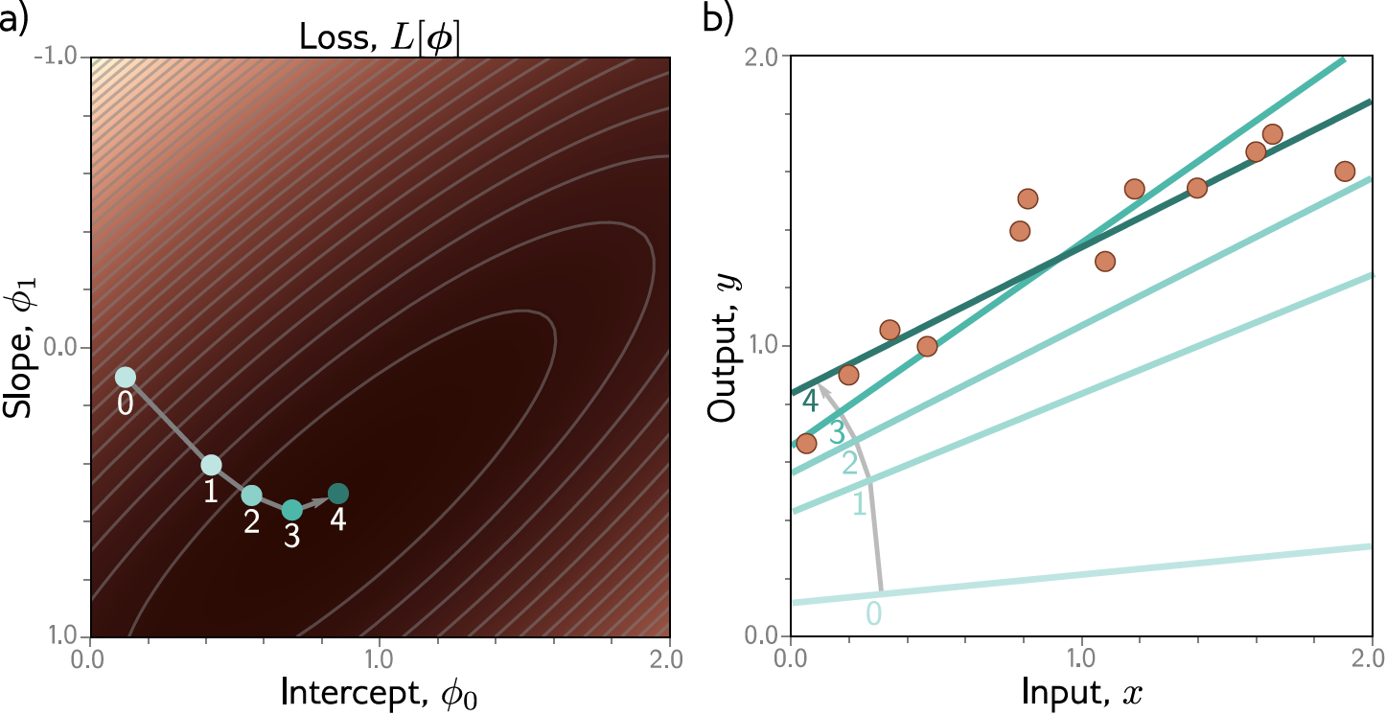
Example: 1D Linear regression training
This technique is known as gradient descent

Slide 46
