Slide 1


CM20315 - Machine Learning
Prof. Simon Prince and Dr. Harish Tayyar Madabushi
1. Introduction

Slide 2


Slide 3
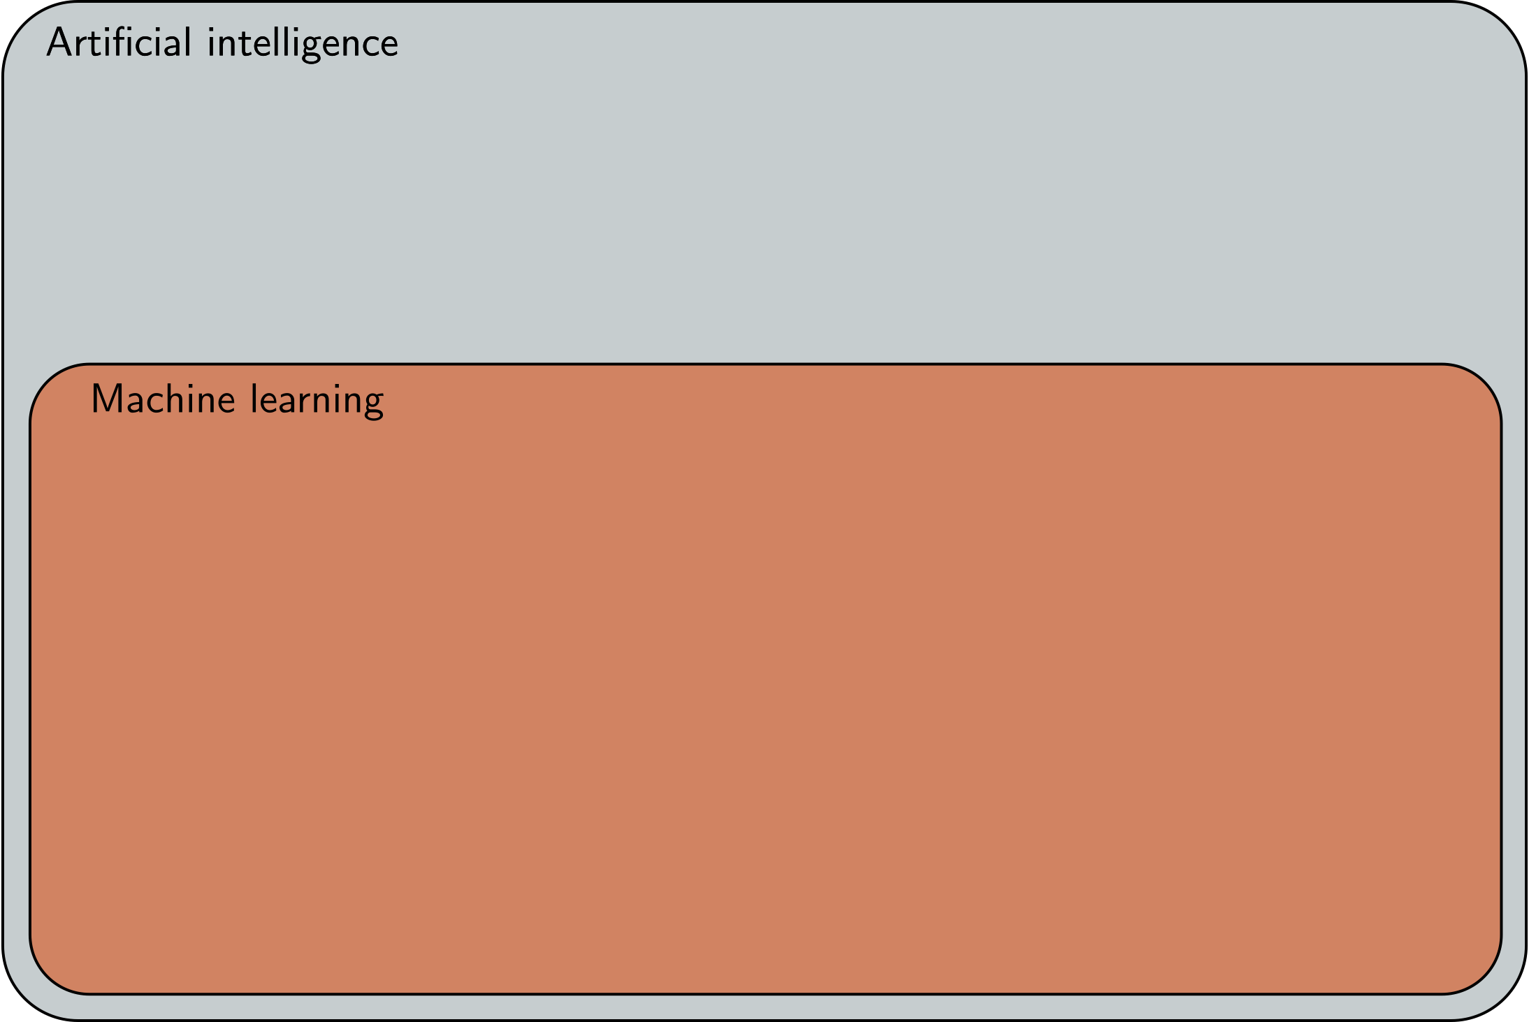

Slide 4
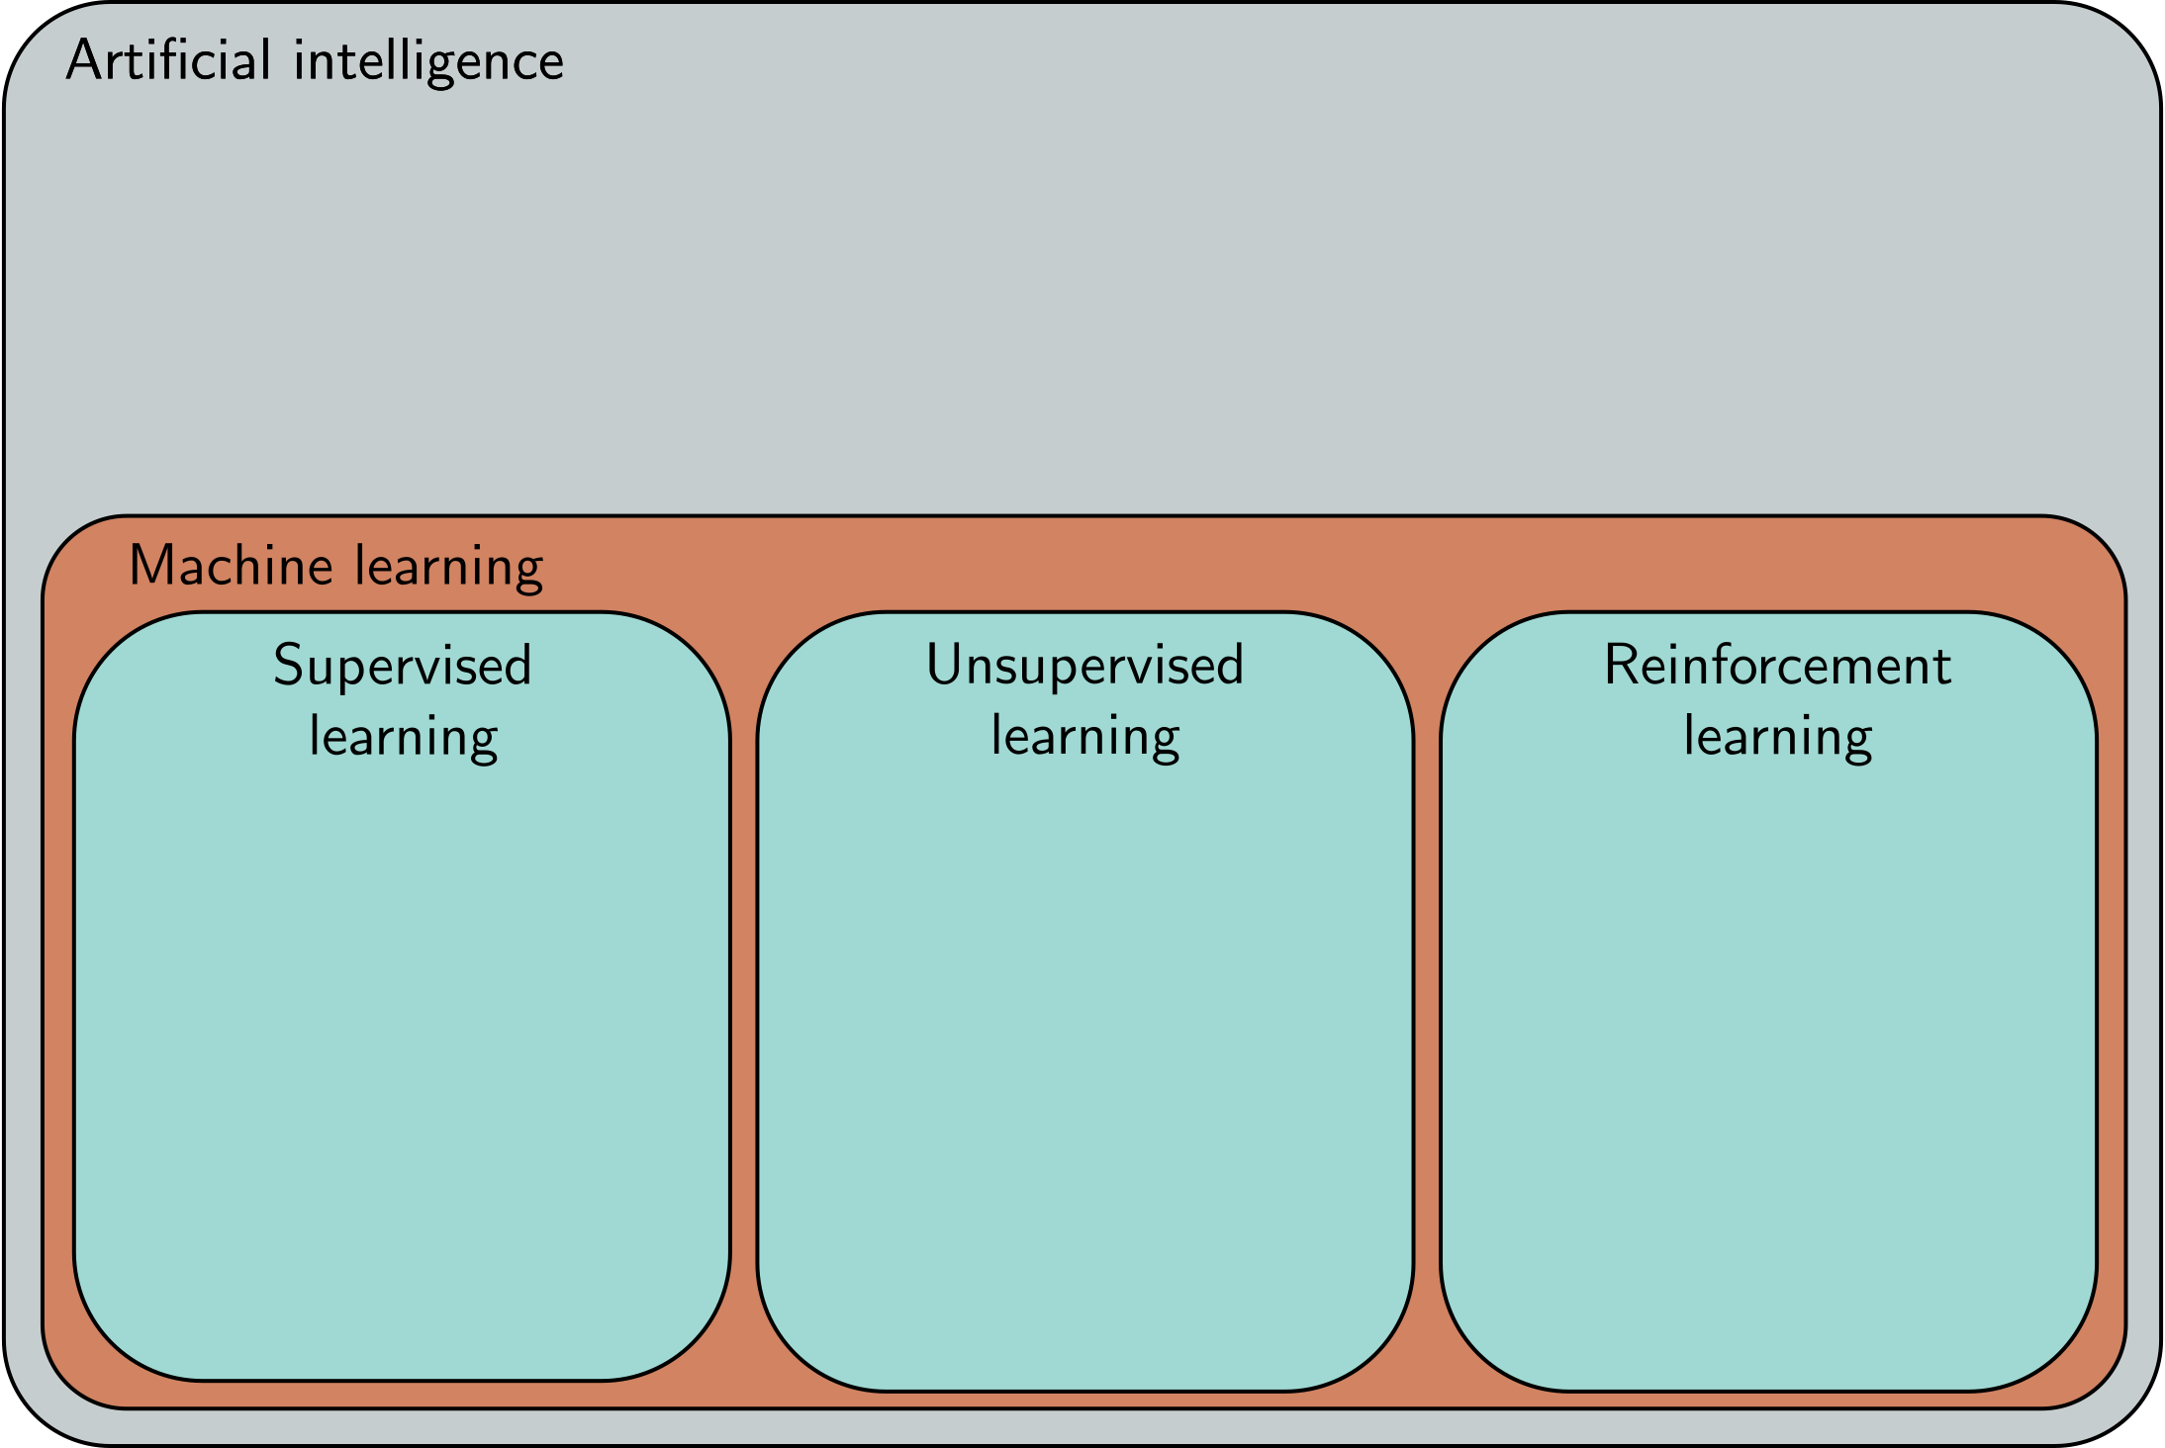

Slide 5
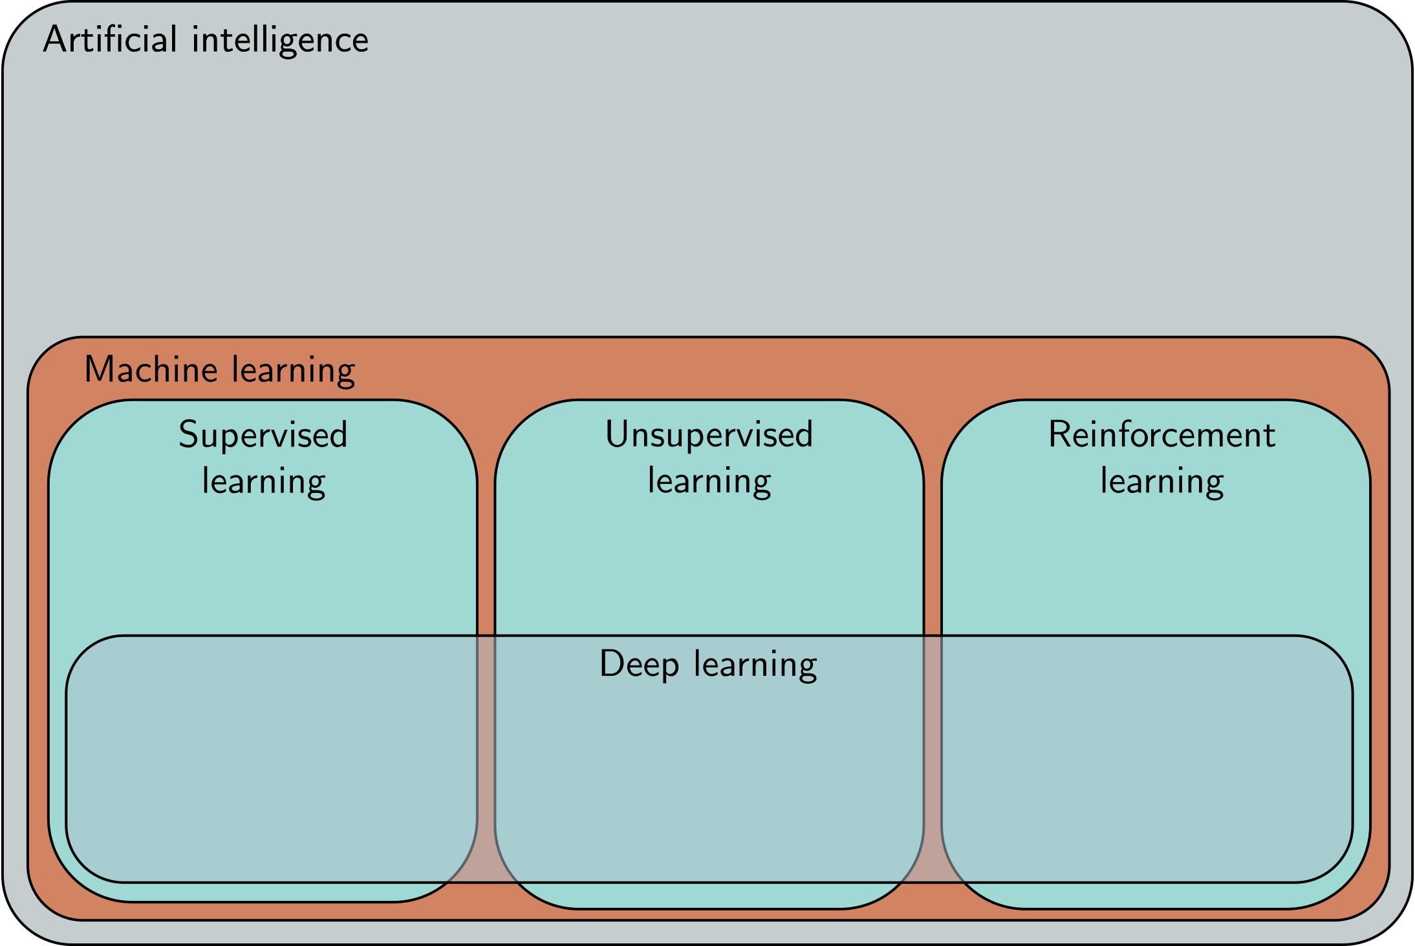

Slide 6
Semester 1

Slide 7
Logistics
Semester 1
  2 lectures per week
  1 lab session per week
  5 weeks / consolidation week / 5 weeks
  1 coursework
    Set Monday 21st November
    Due Monday 5th December
  1 exam (Jan/Feb) – closed book
  Lectures will be recorded
  Slides and notes online
  Ask questions on Moodle logistics message board

Slide 8
Feedback
Please ask questions in the lectures – put your hand up
There will be tutors to help in the labs – sometimes Python programming, sometimes problem sheets
The solutions to the labs will be posted one week after the lab so you can see how you are doing and clear up any misconceptions.
You can ask questions on Moodle
  Please answer other people’s questions if you can!
  There is no such thing as a stupid question.
Anonymous feedback to me via:
  https://forms.office.com/r/UjVD6Yzz01

Slide 9
Lab sessions
Python notebooks in CoLab
You will need a Google account (make one before tomorrow)
  Alternatively, set up Jupyter Notebooks yourself
    Numpy
    Matplotlib
    PyTorch
Problem sheets

Slide 10
How to pass this course
Ideas are simple, but build on one another
Come to all the lectures (take notes)
Come to all the lab sessions
  Complete the Python notebooks
  Complete the problems
  Work together on non-assessed work
Read the notes (and take your own) after the class
Ask questions on the Moodle forums (and answer them)

Slide 11
Book

Slide 12
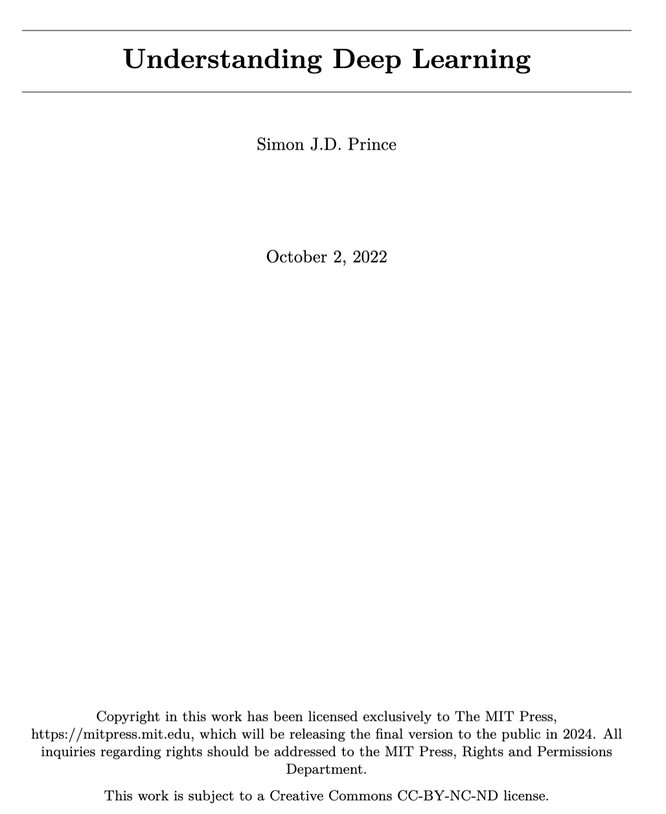
Book
Examinable unless specified
  Chapters 1-11,13

Slide 13
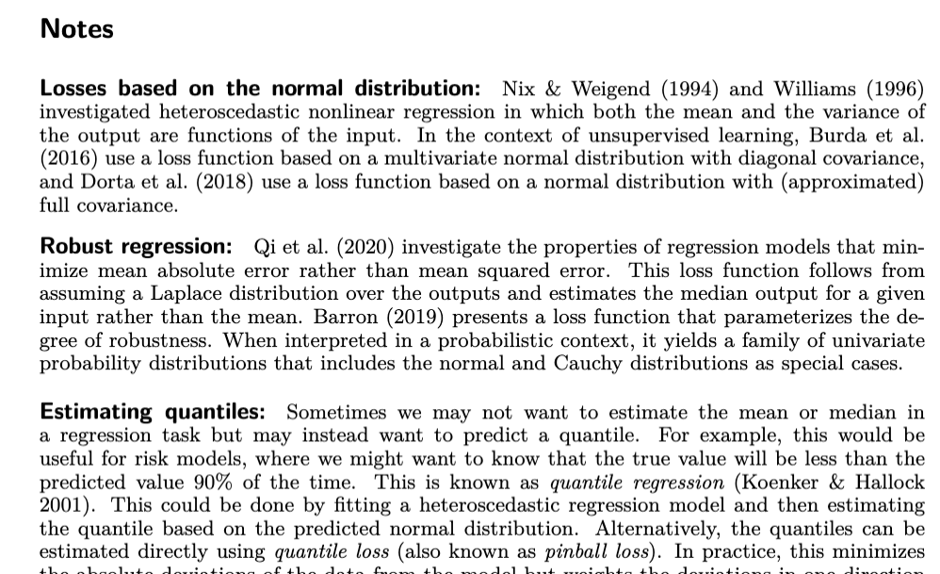
Book
Examinable unless specified
  Chapters 1-11,13
Not examinable unless specified
  Notes at end of chapters

Slide 14
Landmarks in AI
2012 AlexNet (Image classification)
2014 Generative adversarial networks (Image generation)
2016 AlphaGo
2017 Machine translation
2019- Language models (Bert, GPT3)
2022 Dall-E2 (Image synthesis from text prompts)

Slide 15
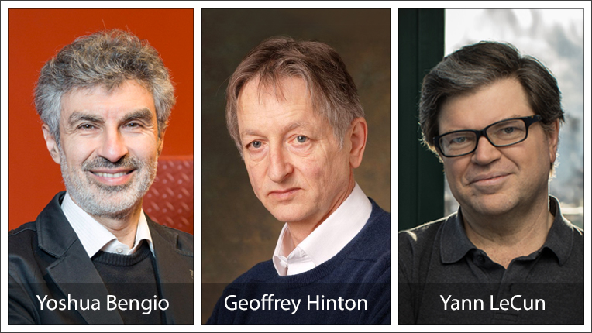
2018 Turing award winners

Slide 16
Deep Learning
Supervised learning
  Tasks
  Models
  Deep learning models
Unsupervised learning
  Generative models
  Probabilistic generative models
  Latent variable models
Reinforcement learning

Slide 17
Deep Learning
Supervised learning
  Tasks
  Models
  Deep learning models
Unsupervised learning
  Generative models
  Probabilistic generative models
  Latent variable models
Reinforcement learning

Slide 18
Supervised learning
Define a mapping from input to output
Learn this mapping from paired input/output data examples

Slide 19
Five simple examples

Slide 20
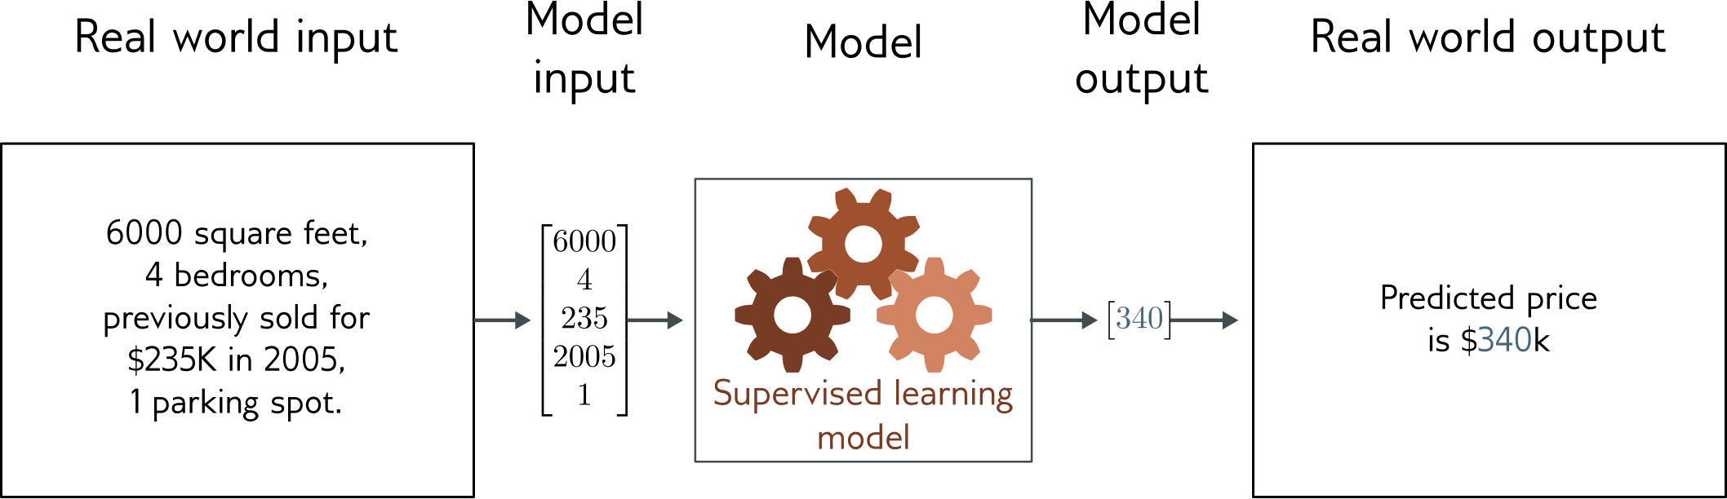
Regression
Univariate regression problem (one output, real value)
Fully connected network

Slide 21
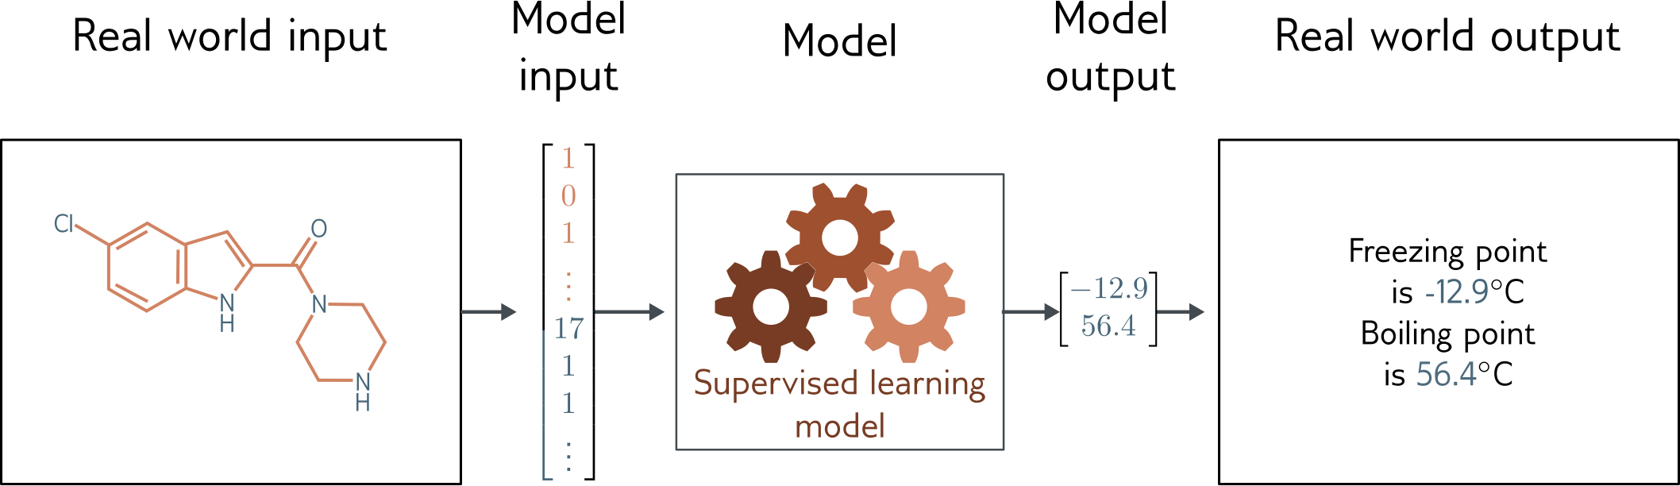
Graph regression
Multivariate regression problem (>1 output, real value)
Graph neural network

Slide 22
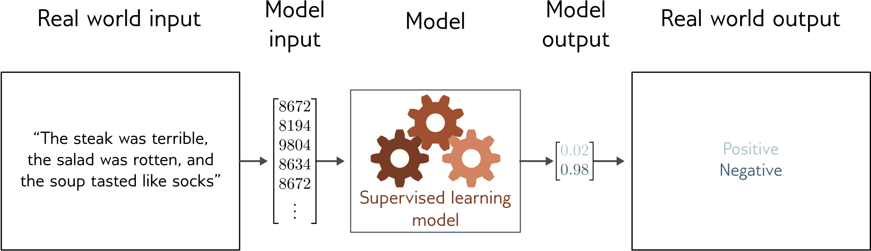
Text classification
Binary classification problem (two discrete classes)
Transformer network

Slide 23
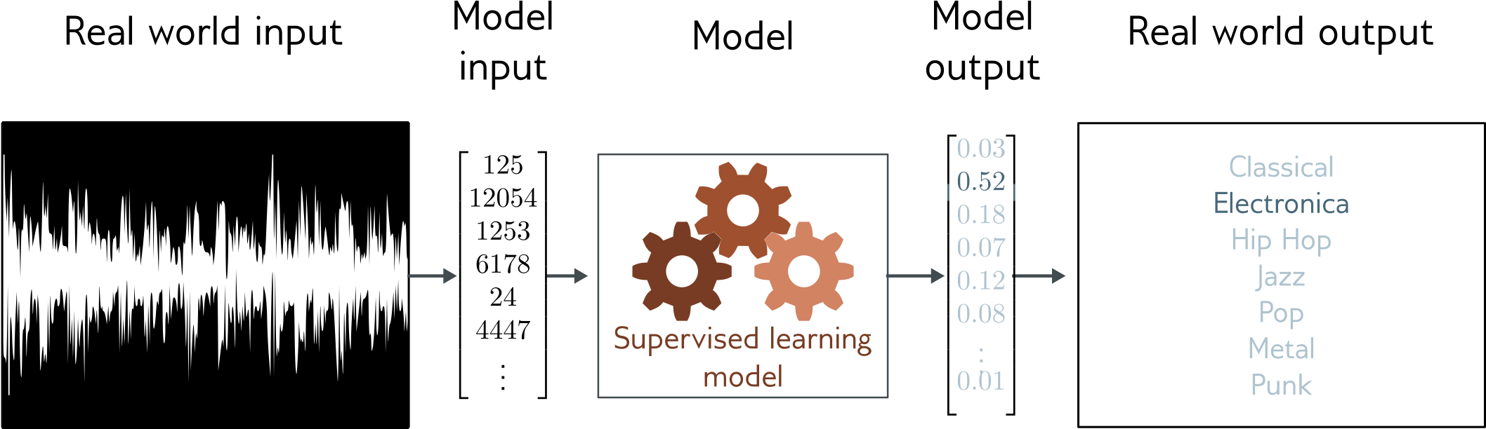
Music genre classification
Multiclass classification problem (discrete classes, >2 possible values)
Convolutional network

Slide 24
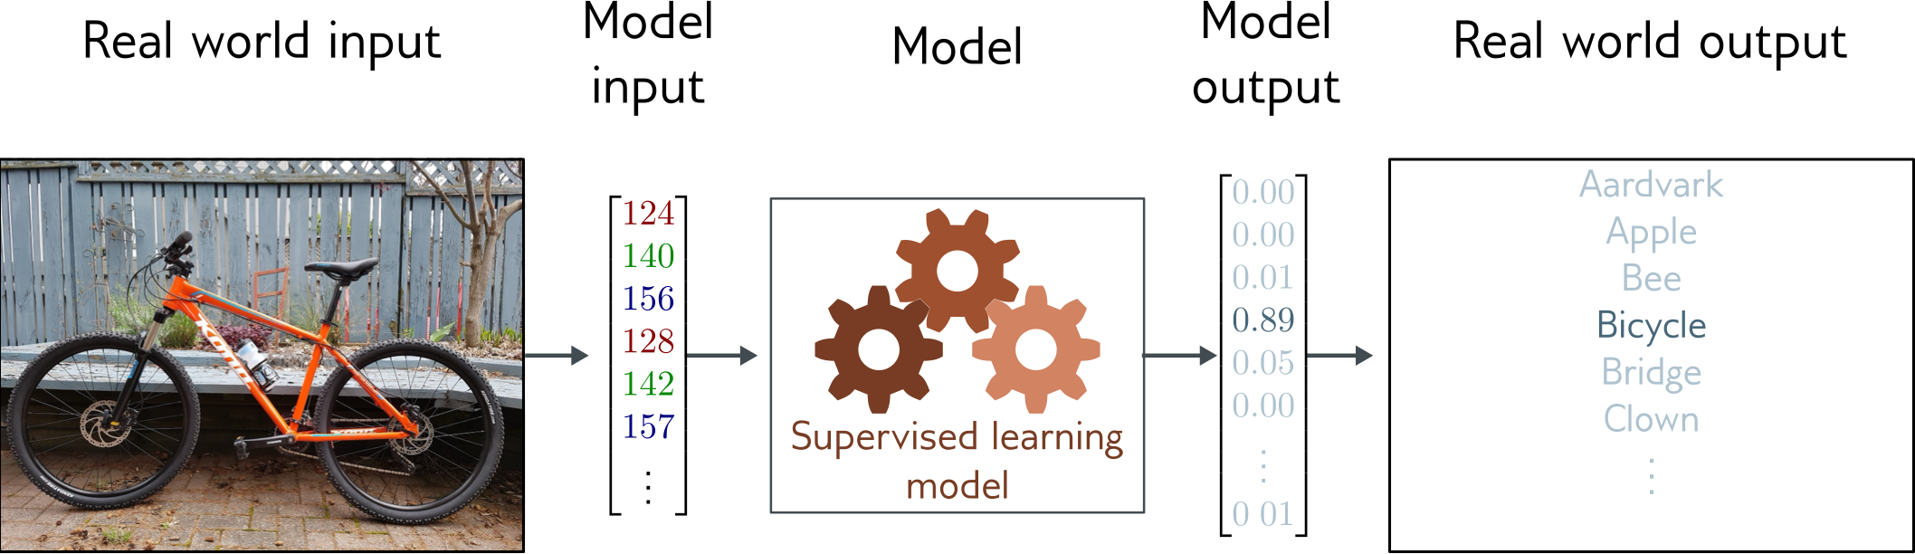
Image classification
Multiclass classification problem (discrete classes, >2 possible classes)
Convolutional network

Slide 25
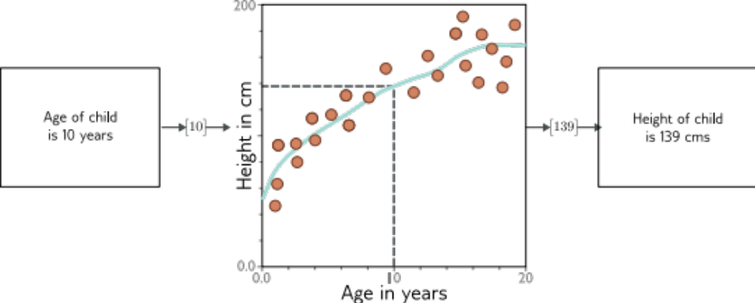
What is a supervised learning model?
An equation relating input (age) to output (height)
Search through family of possible equations to find one that fits training data well

Slide 26
What is a supervised learning model?
Deep neural networks are just a very flexible family of equations
Fitting deep neural networks = “Deep Learning”

Slide 27
Five more examples
More complex outputs
But constrained by input (labelling)

Slide 28
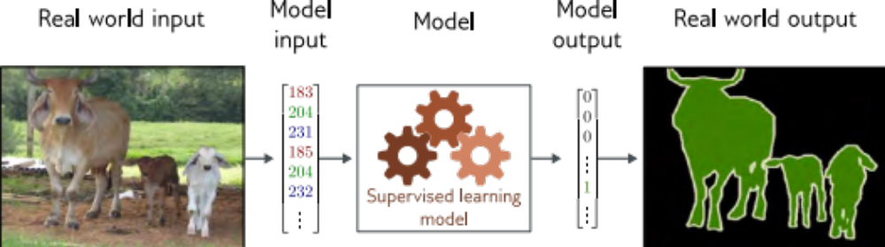
Image segmentation
Multivariate binary classification problem (many outputs, two discrete classes)
Convolutional encoder-decoder network

Slide 29
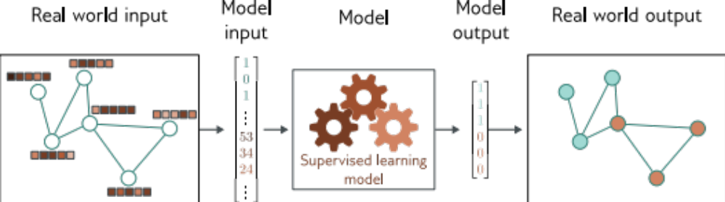
Graph node classification
Multivariate binary classification problem (many outputs, two discrete classes)
Graph neural network

Slide 30
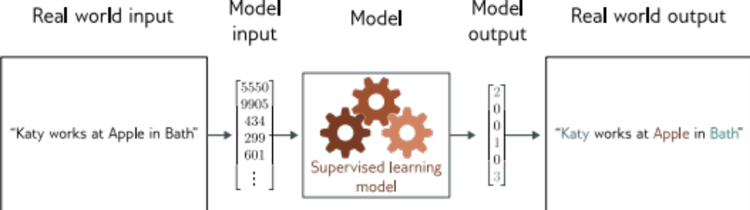
Entity classification
Multivariate multiclass classification
Transformer network

Slide 31
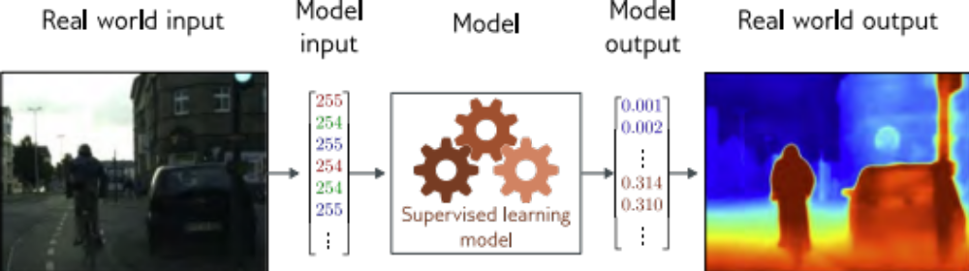
Depth estimation
Multivariate regression problem (many outputs, continuous)
Convolutional encoder-decoder network

Slide 32
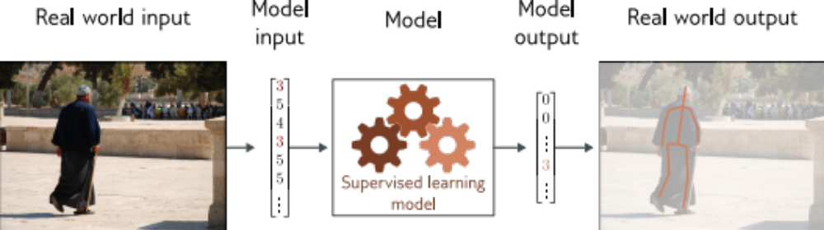
Pose estimation
Multivariate regression problem (many outputs, continuous)
Convolutional encoder-decoder network

Slide 33
Terms
Classification = discrete classes as output
Regression = continuous numbers as output
Two class and multiclass classification treated differently
Univariate = one output
Multivariate = more than one output

Slide 34
Three more examples

Slide 35
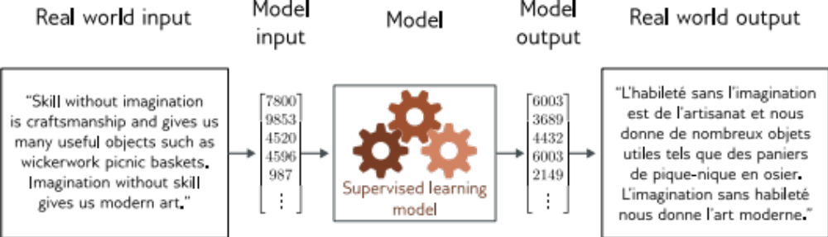
Translation

Slide 36
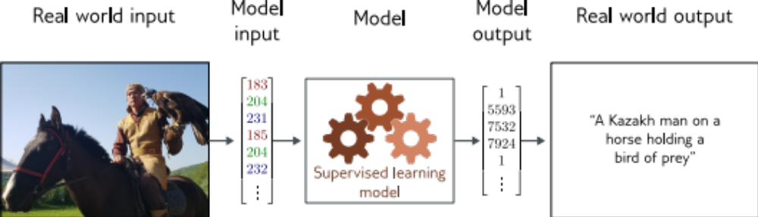
Image captioning

Slide 37
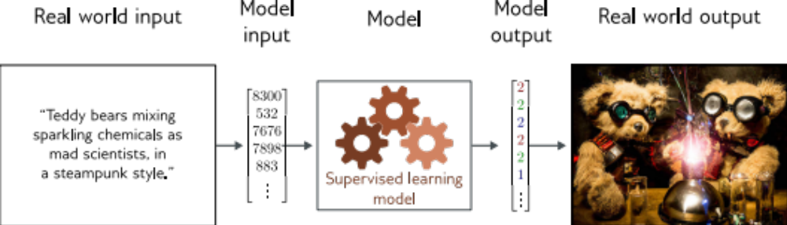
Image generation from text

Slide 38
What do these examples have in common?
Very complex relationship between input and output
Sometimes may be many possible valid answers
But outputs (and sometimes inputs) obey rules
Language obeys grammatical rules
Natural images also have “rules”

Slide 39
Idea
Learn the “grammar” of the data from unlabeled examples
Can use a gargantuan amount of data to do this (as unlabeled)
Make the supervised learning task earlier by having a lot of knowledge of possible outputs

